Slide 1

RSA (1): Representation
Choong-Wan Woo
Director of the Cocoan Lab

Slide 2
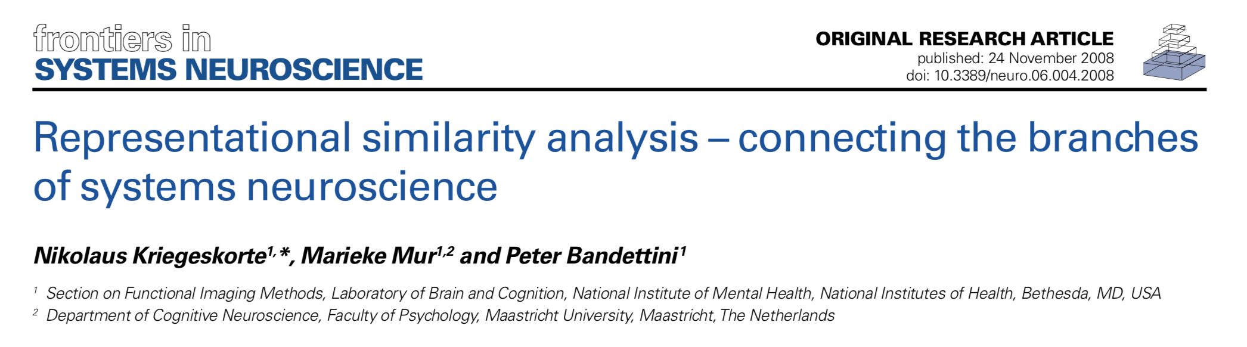
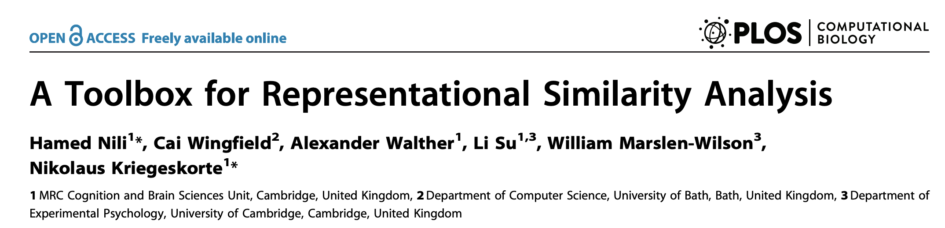
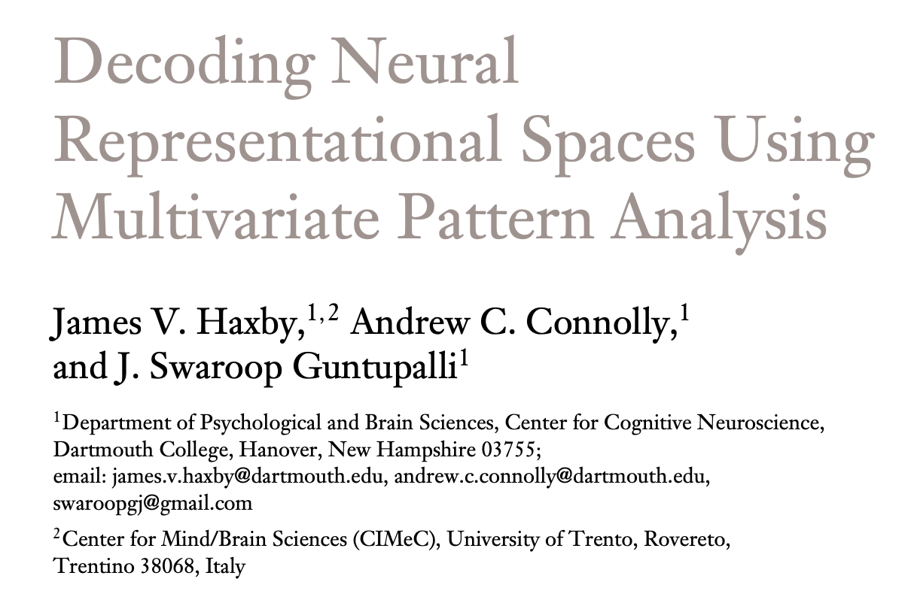
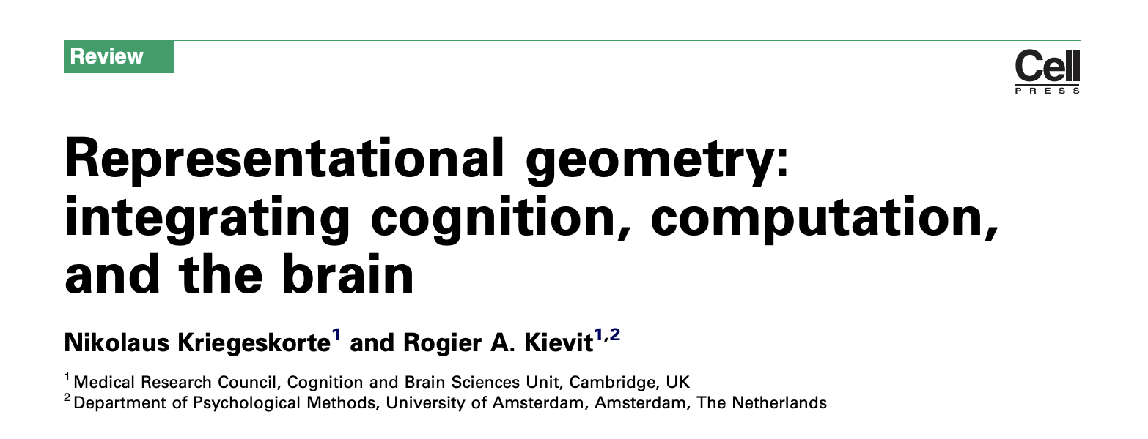
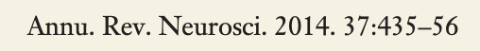
Key references
the original RSA paper
Cited by 1996 (2021. 4. 23)

Slide 3
Representational similarity analysis
Let’s start with the following three questions:
What is…
Representation?
Representational space?
Representational geometry?

Slide 4

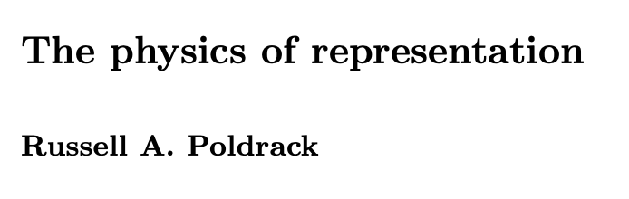
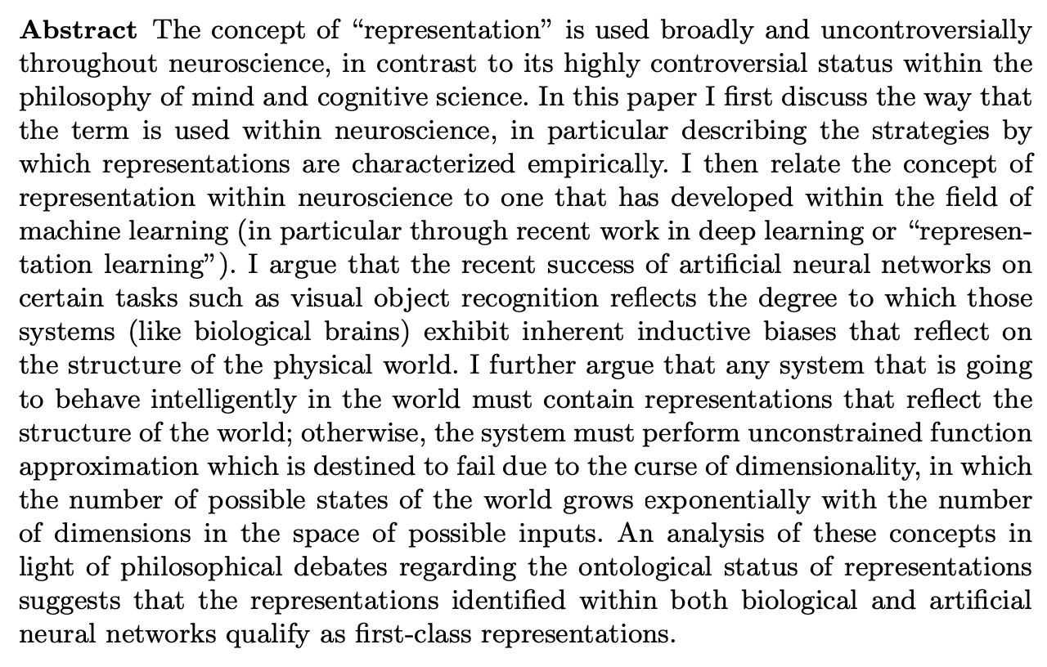
Key references
http://philsci-archive.pitt.edu/17455/

Slide 5
Representation?
Russ Poldrack:
Representation refers to... “patterns of activity that bear a systematic relationship to the structure of the external world and play a causal role in behavior, is fundamentally necessary for any intelligent organism”
Relevant terms:
Functional isomorphism
Functional approximation
Dimensionality reduction

Slide 6
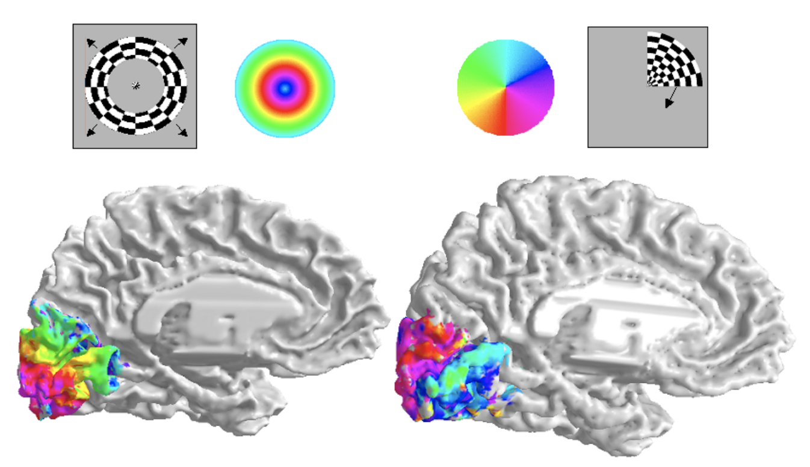
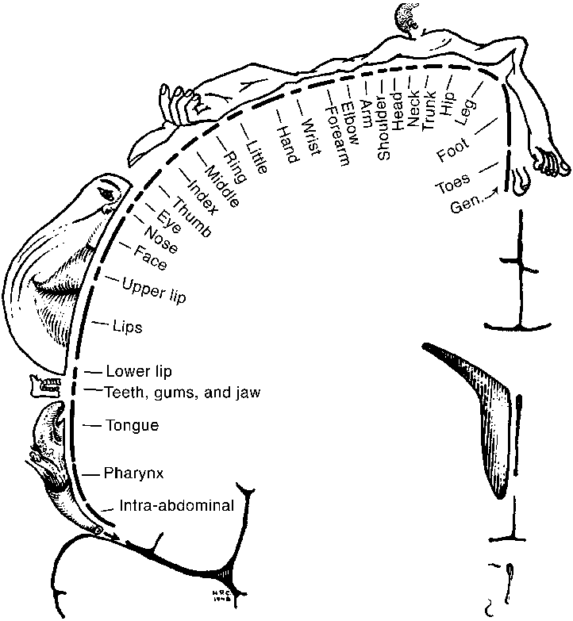
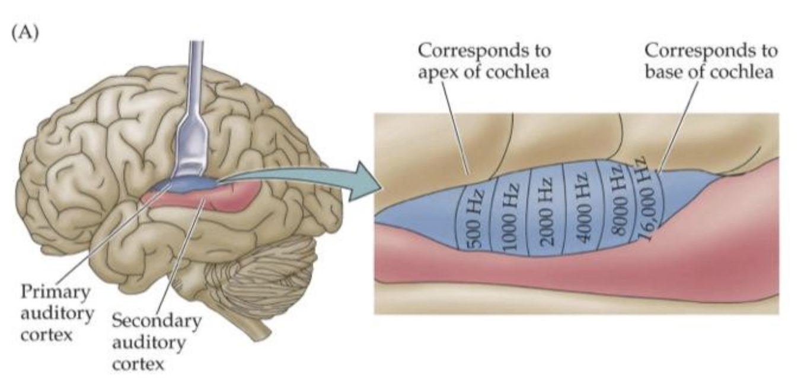
Representation?
Simple forms of brain representation
Retinotopy (Dougherty et al., 2003)
Penfield's sensory homunculus (Penfield & Rasmussen, 1950)
Tonotopy
from https://medium.com/@mosaicofminds/maps-in-the-brain-f236998d544f

Slide 7
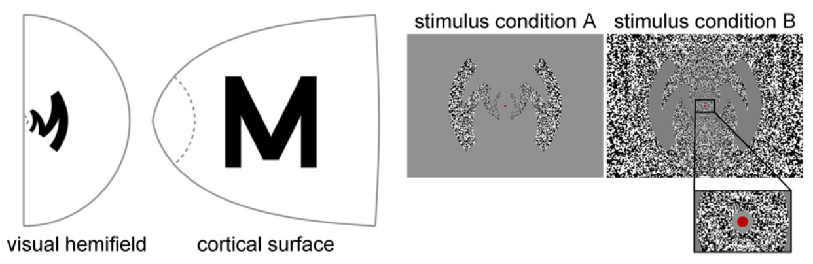
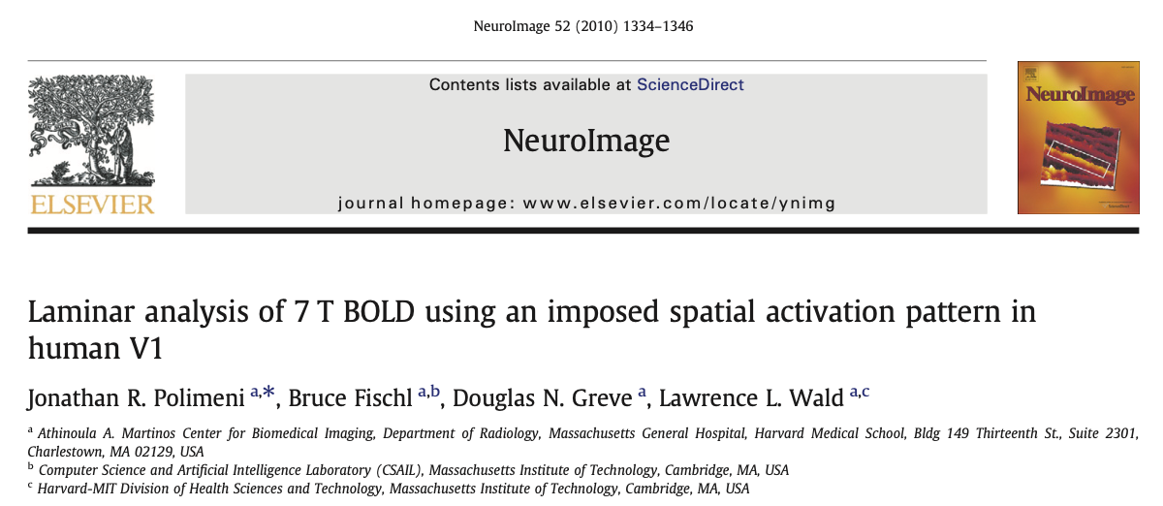
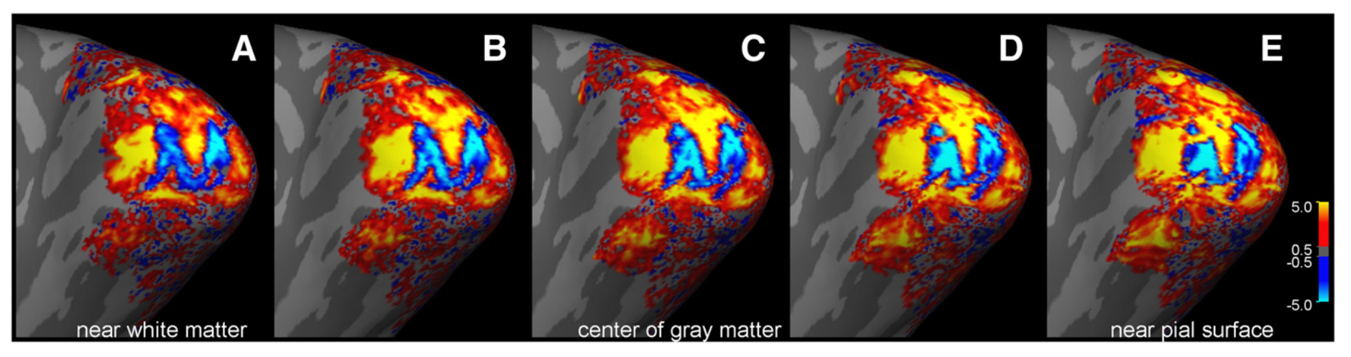
Representation?
structurally isomorphic (between the neural and external worlds)

Slide 8
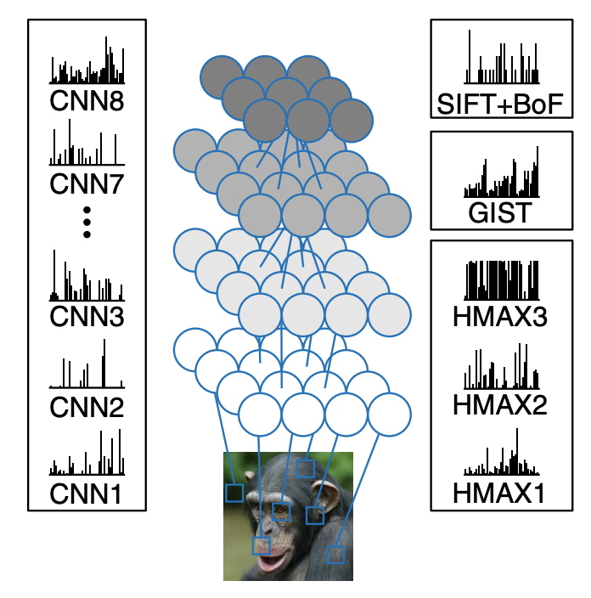
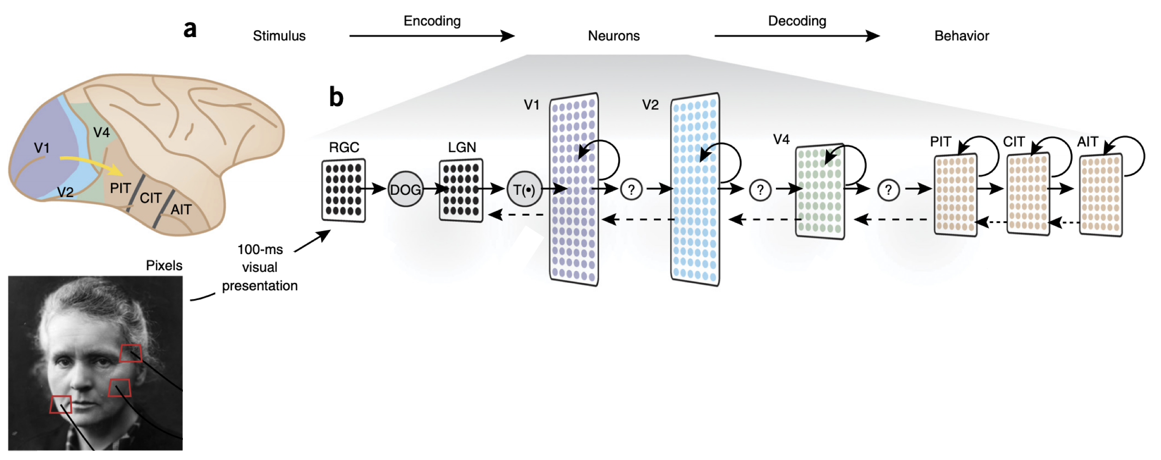
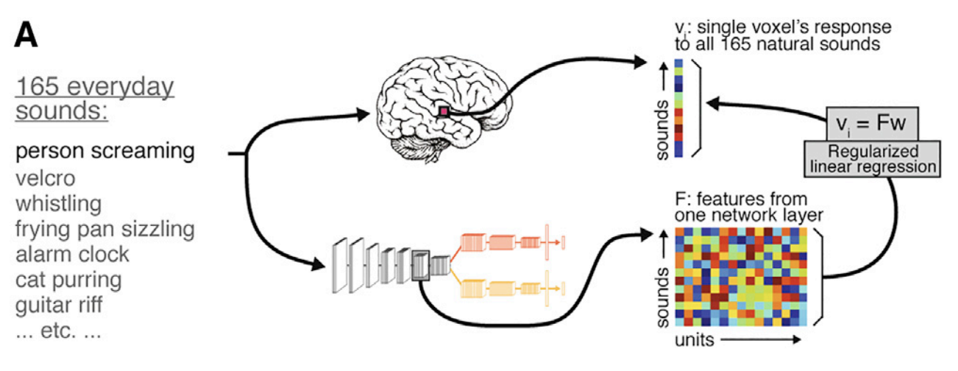
Different systems, different representations
Yamins et al., 2016, Nat Neurosci
Horikawa et al., 2017, Nat Comms
Kell et al., 2018, Neuron

Slide 9
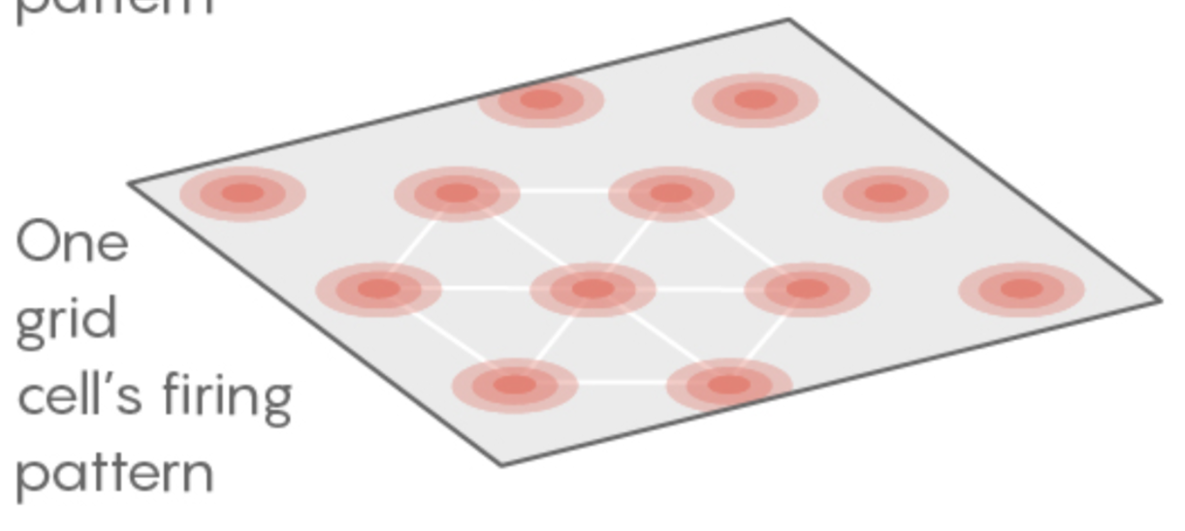
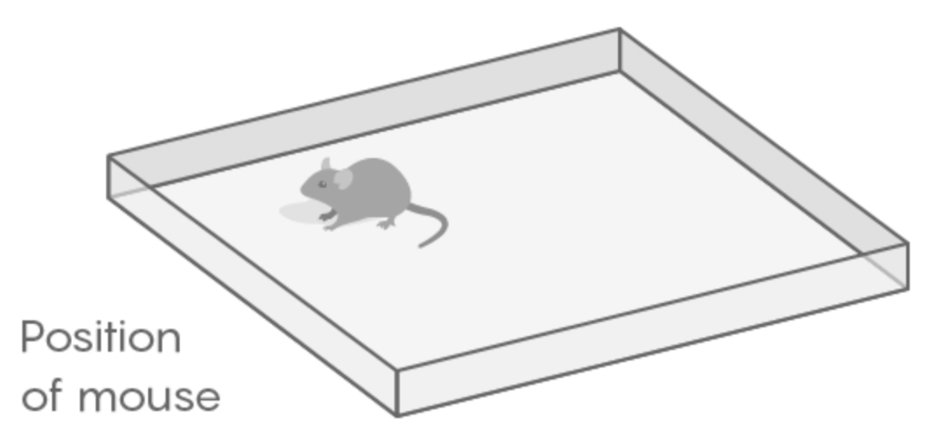
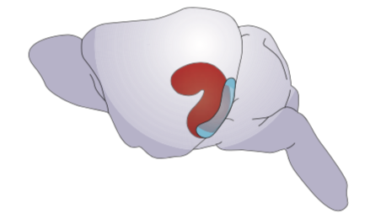
Beyond sensory information processing
Mouse entorhinal cortex
A spatial location can be represented in very different forms across different systems
36°41'37.6"N 126°39'21.6"E
(longitude and latitude)
Maps
Computer
Binary code
Image sources: https://www.quantamagazine.org/the-brain-maps-out-ideas-and-memories-like-spaces-20190114/
Behrens et al., 2018, Neuron

Slide 10
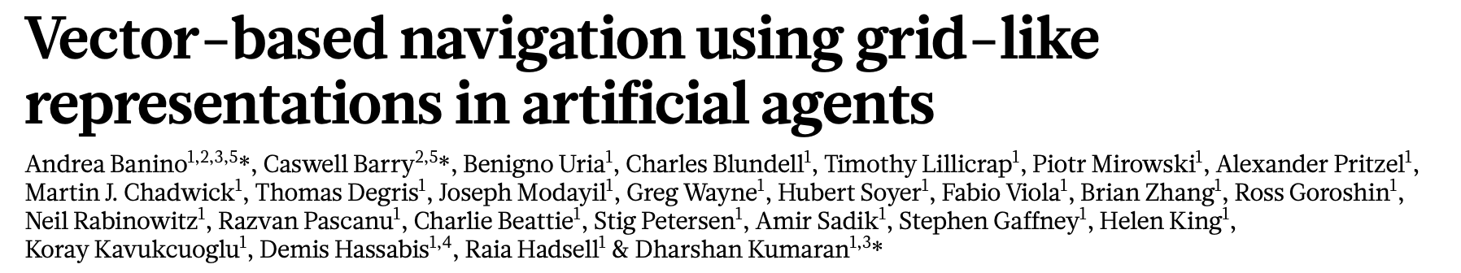
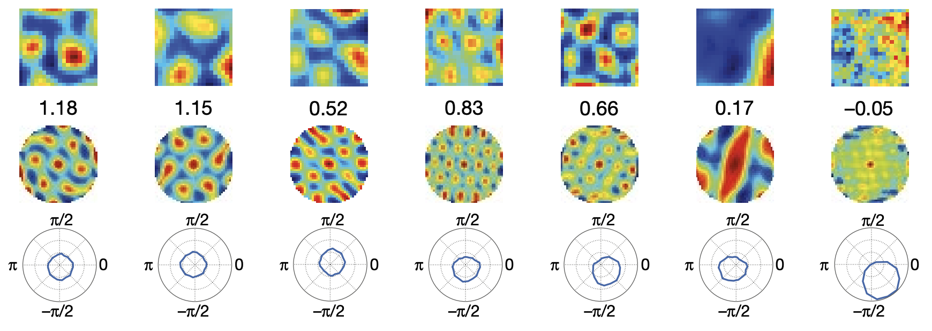
Beyond sensory information processing
Mouse entorhinal cortex
A spatial location can be represented in very different forms across different systems
Banino et al., 2018, Nature

Slide 11
Criteria for brain representations?
Establishing tighter associations between the mind and the brain:
a. Pain a Brain activation (e.g., regions, or patterns)
e.g., P(Brain | Pain), sensitivity, forward inference
b. Large effect size between pain and the brain measure
e.g., Cohen’s d, explained variance (R²), etc.
c. Not pain a No brain activation
e.g., P(~Brain | ~Pain), specificity
d. Brain activation a Pain
e.g., P(Pain | Brain), positive predictive value, brain decoding, reverse inference
Woo et al., 2017, Nat Neurosci; Woo et al., 2015, Pain

Slide 12
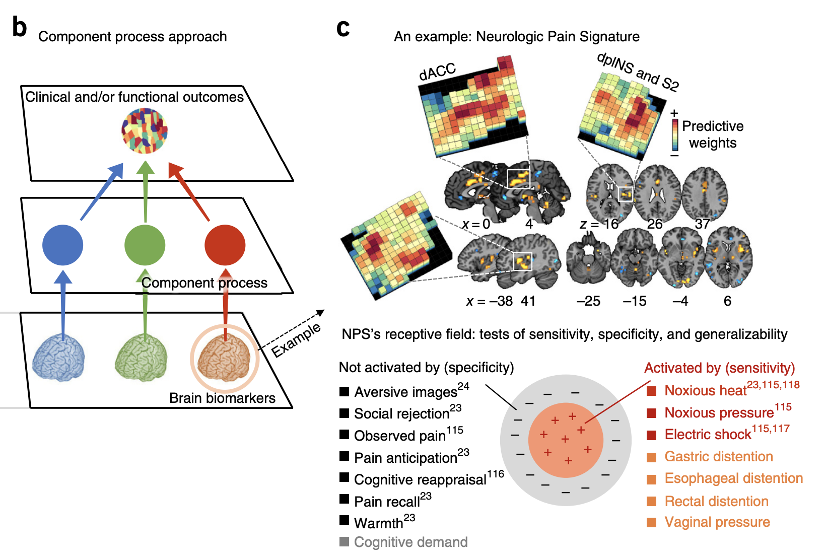
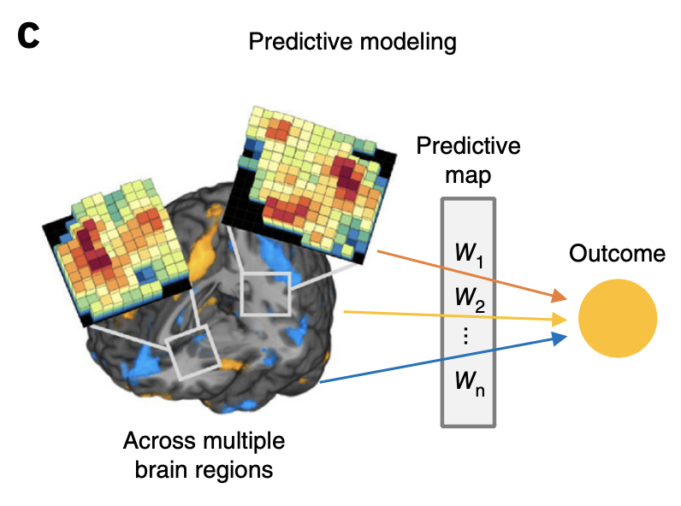
Building brain biomarkers
= identifying good brain representations
Woo et al., 2017, Nat Neurosci; Wager et al., 2013, NEJM

Slide 13
Some challenges in studying representations
Difficult to identify (or develop) good representations
Difficult to use (or compare) representations from different systems (or models)
e.g., different dimensions, different shapes, etc.
Solution? Use representational distance (or representational similarity) instead

Slide 14
Social network as an example
To find a potential friends...
We first need to know who I am (let’s say its a representation) and find people similar to me
But it is really difficult to know!
Then, we can use the structure of representational similarity!

Slide 15
Social network as an example
For example,
see how you categorize (or link) people! (e.g., facebook friends)
Compare your categories (or links) with other people
→ you may find your soulmates!
Representational similarity analysis?
Examining the distances among people from my point of view
And comparing it with your distance for people

Slide 16
Limitations of the representational similarity approach
One challenge with the analysis of similarity spaces is that they are fundamentally indeterminate.
There is no single “correct” similarity space within which to compare patterns of activity, just as in general there is no single “correct” decomposition of a dataset into lower dimensionality.
The most common uses of representational similarity analysis attempt to sidestep this issue, by comparing similarity spaces computed according to a common similarity metric.
For example, we might compute the similarity between patterns of neural activity for different stimuli using a particular similarity measure, and then further compare the second-order similarity of these similarity patterns across species or experimental conditions.
This does not absolve the approach of indeterminacy; it simply pushes that indeterminacy down to a level below the inferences that are being made.
However, neuroscientists are generally comfortable endorsing claims about the similarity of representational spaces, despite the fact that there is no unique underlying space in which they can be defined.
Poldrack, 2020, p. 6

Slide 17
RSA (2): Representational space and Representational similarity analysis (RSA)
Choong-Wan Woo
Director of the Cocoan Lab

Slide 18
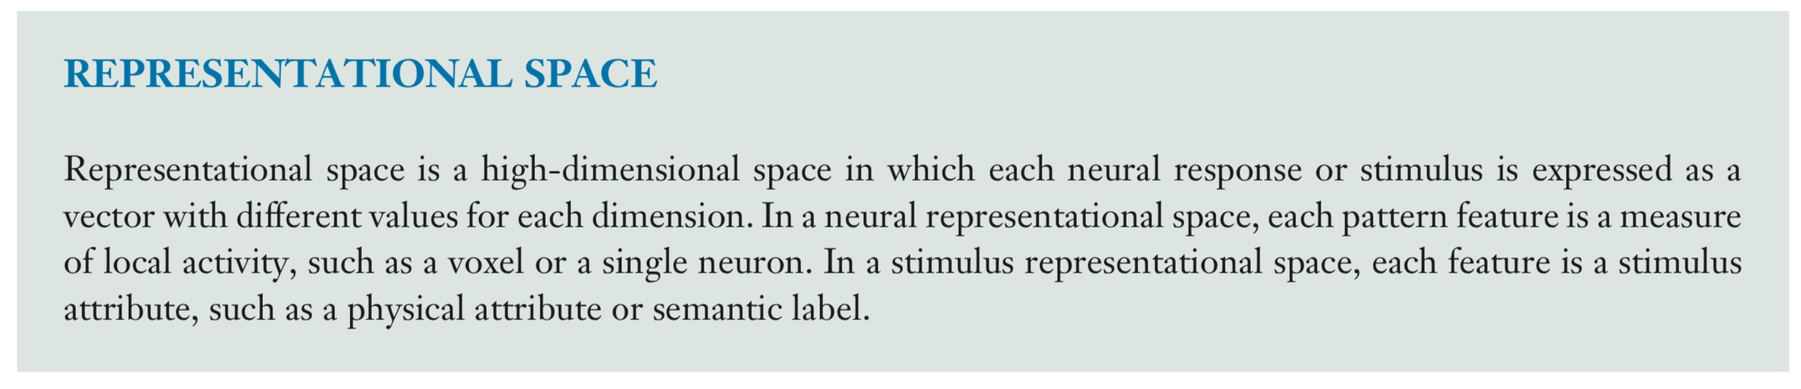
Representational space
Poldrack, 2020
“a low-dimensional projection of the responses across stimuli”
“a low-dimensional embedding”
Haxby et al., 2014, Annu Rev Neurosci

Slide 19
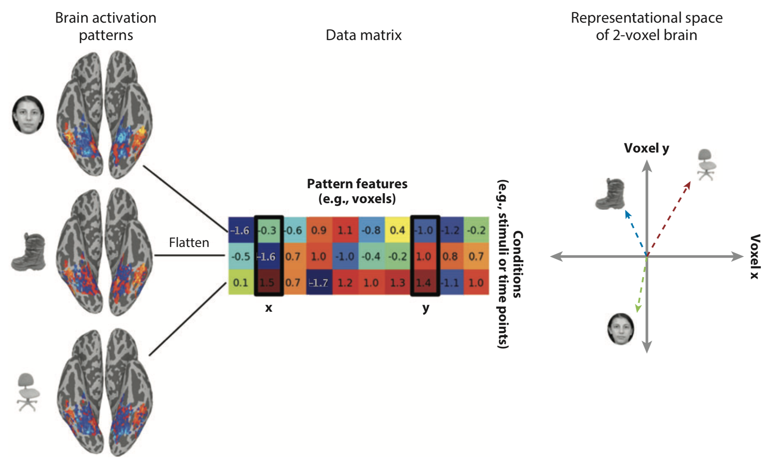
Representational space
inanimate
animate
Any types of embedding can be used! (e.g., animate vs. inanimate?)
Haxby et al., 2014, Annu Rev Neurosci

Slide 20
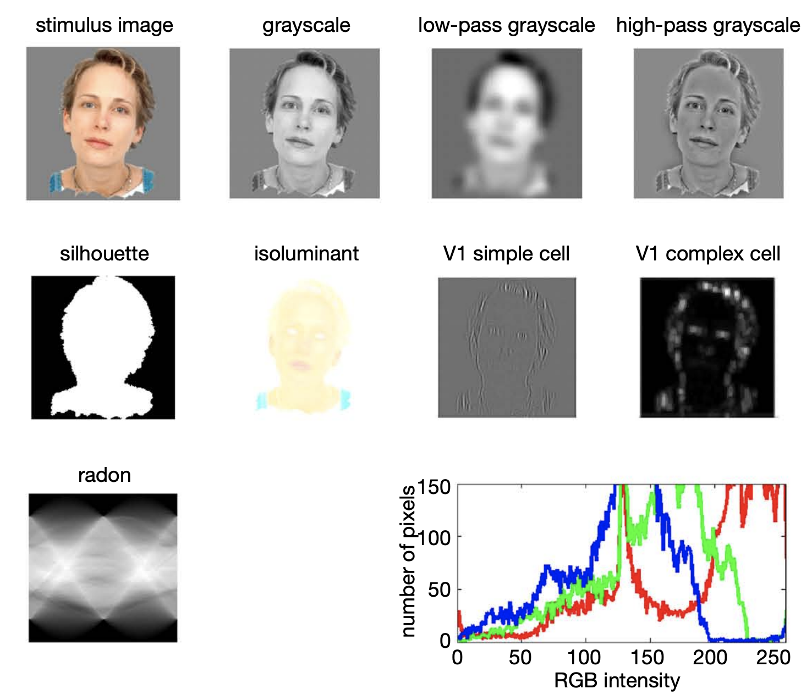
Representational space
Any embeddings can be used!
Horikawa et al., 2017, Nat Comms
Kriegeskorte et al., 2008, Front Sys Neurosci

Slide 21
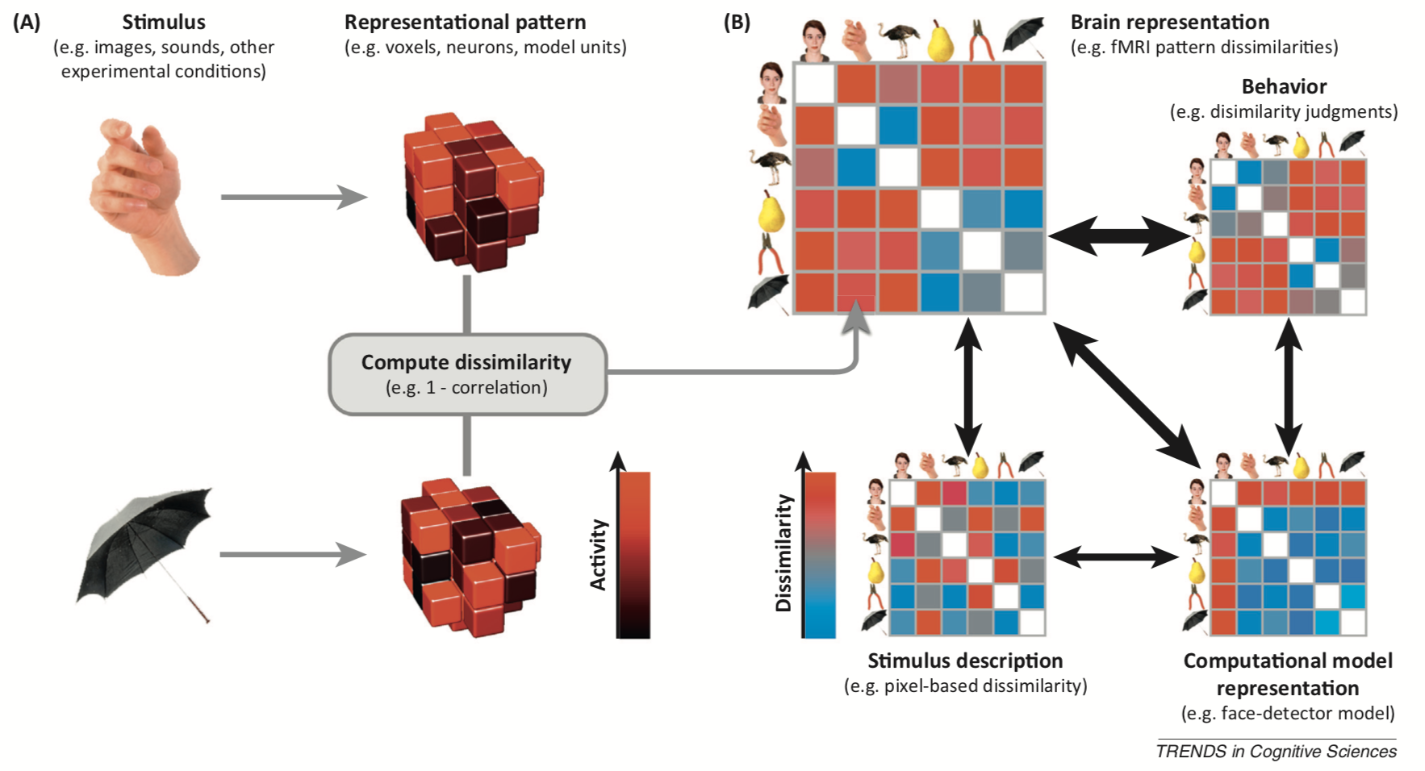
Representational dissimilarity matrix
Kriegeskorte et al., 2013, TICS

Slide 22
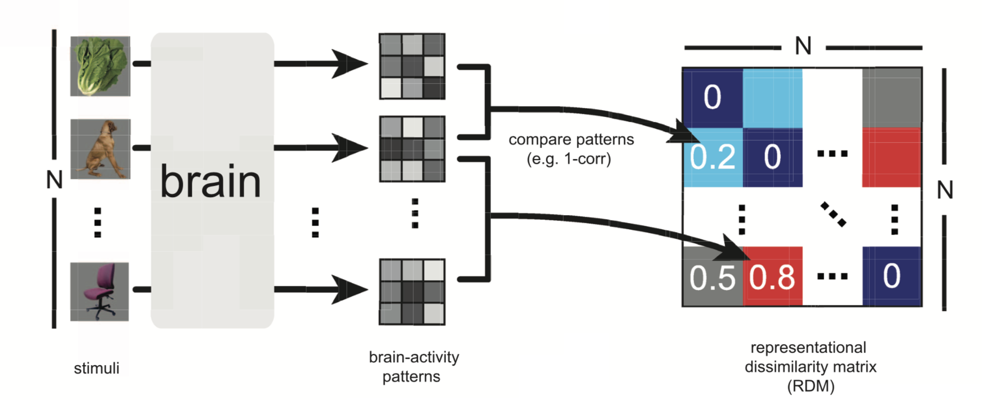
Representational dissimilarity matrix (in more detail)
Brain or
Other model representations
Nili et al., 2014, PLoS Comp Biol

Slide 23
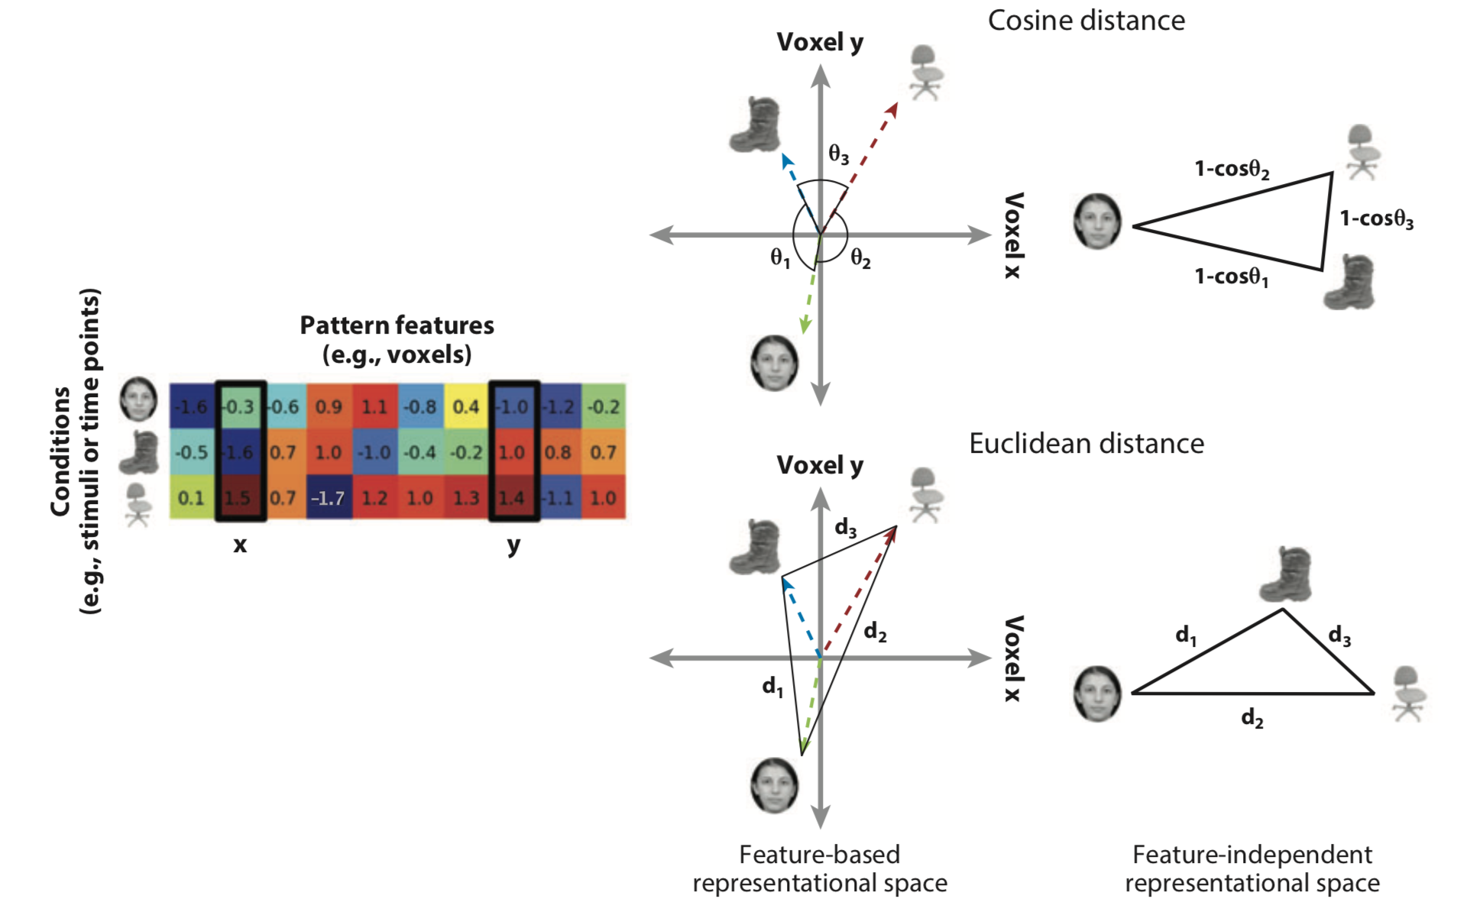
Representational dissimilarity matrix (in more detail)
Other types of distance metric can be used (e.g., cosine, Euclidean, classification accuracy, etc.)
Haxby et al., 2014, Annu Rev Neurosci

Slide 24
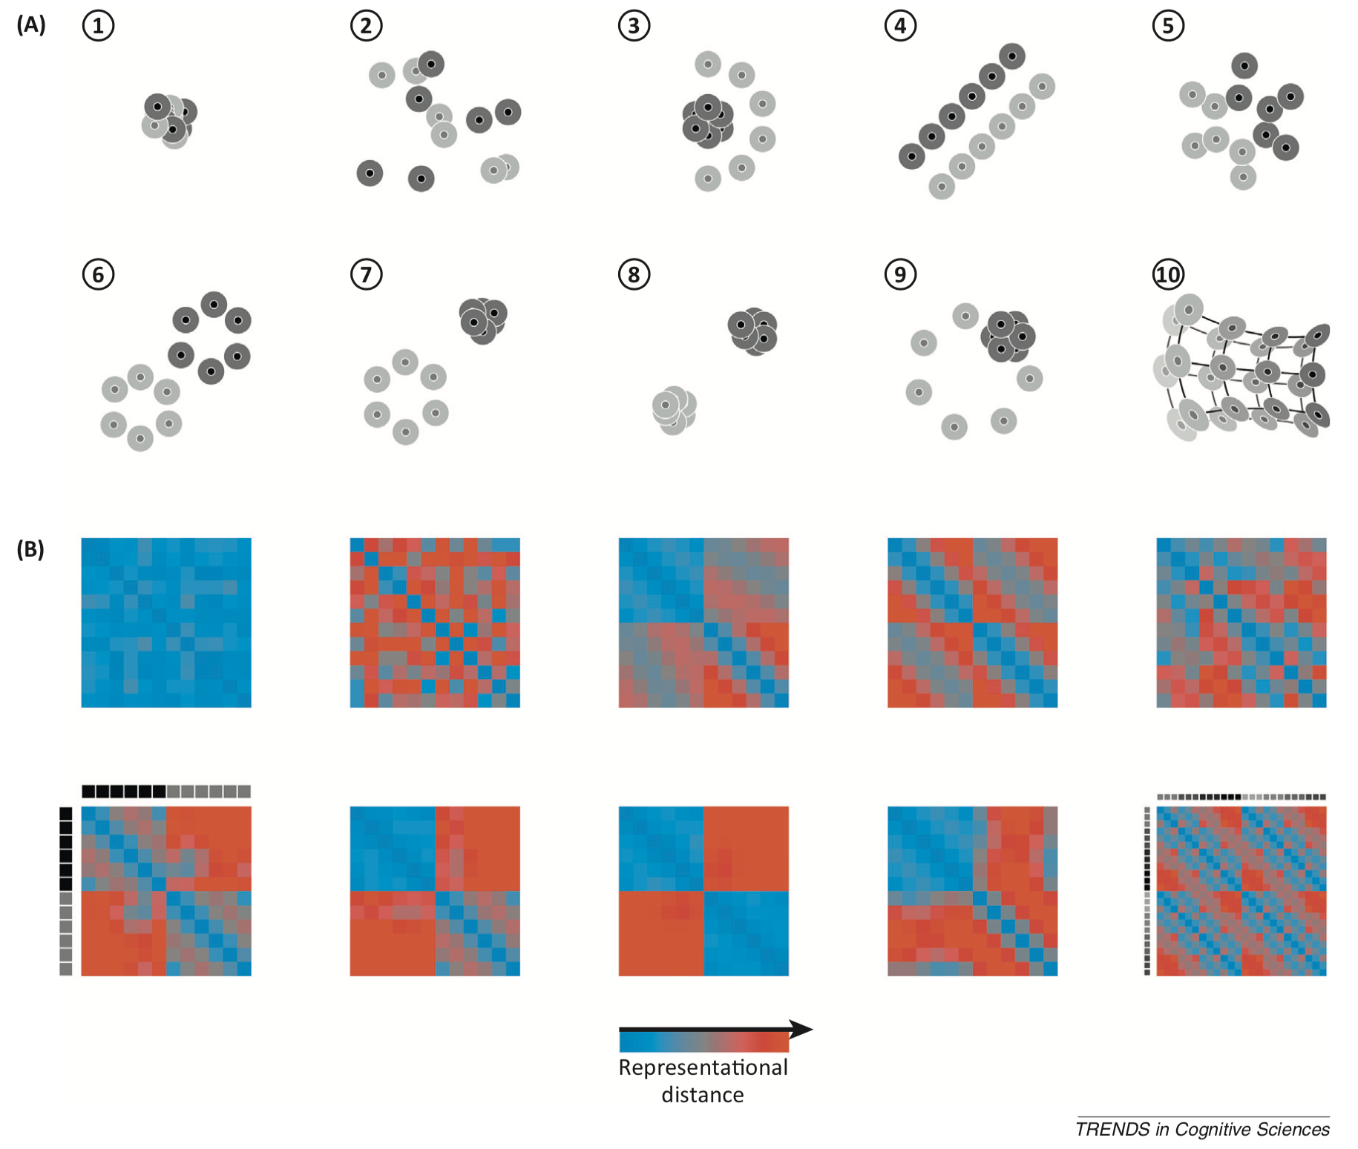
Representational geometry
Representational geometry
Representational dissimilarity matrix
Kriegeskorte et al., 2013, TICS

Slide 25
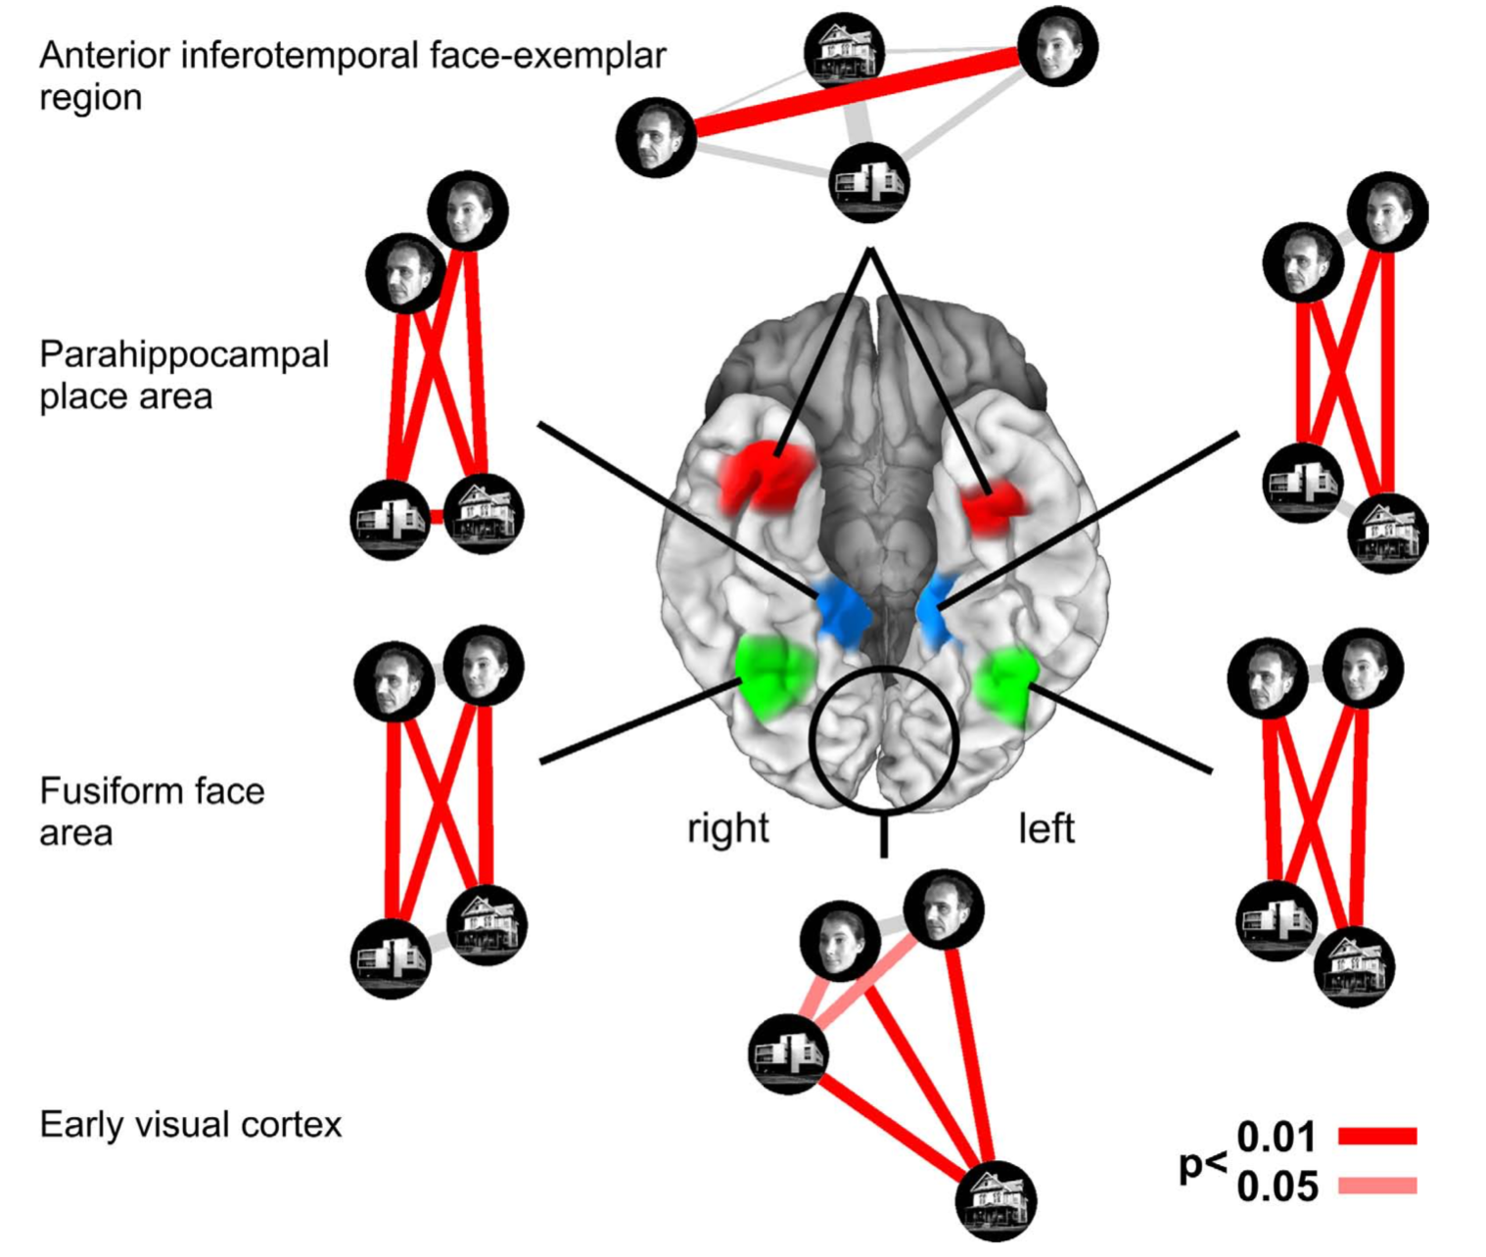
Representational dissimilarity matrix (in more detail)
Different representational geometry
from different representational dissimilarity patterns of different brain regions
Kriegeskorte et al., 2008, Front Sys Neurosci

Slide 26
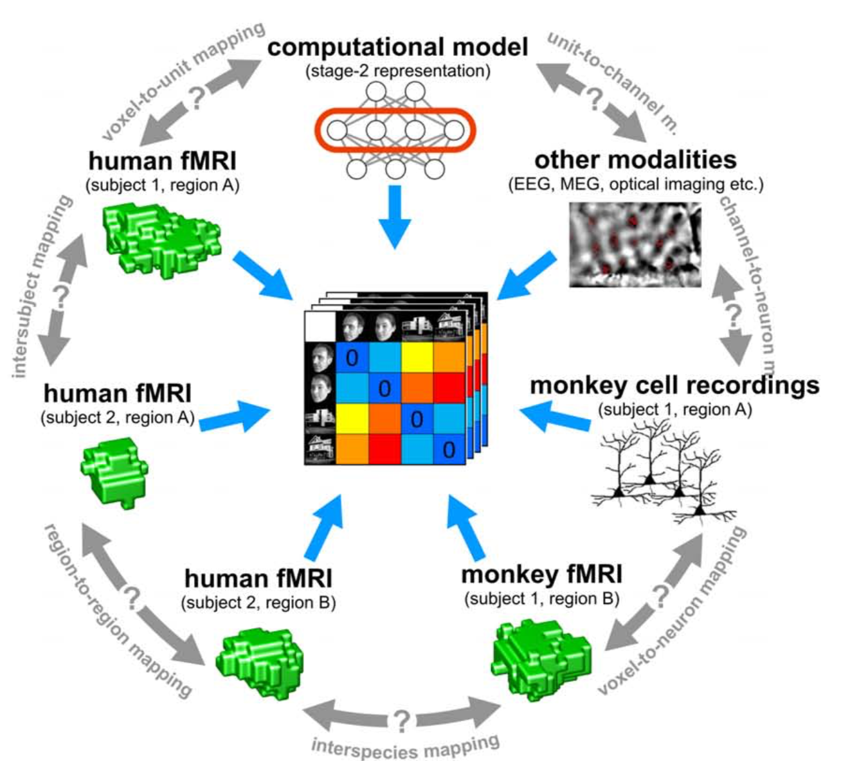
Basic idea: You can compare any models/systems using RDM!
Kriegeskorte et al., 2008, Front Sys Neurosci

Slide 27
RSA (3): Analysis steps for RSA
Choong-Wan Woo
Director of the Cocoan Lab

Slide 28
Three steps of representational similarity analysis
Step 1: Computing and visualizing RDMs
Step 2: Comparing brain and model RDMs
Step 3: Statistical inference
Nili et al., 2014, PLoS Comp Biol

Slide 29
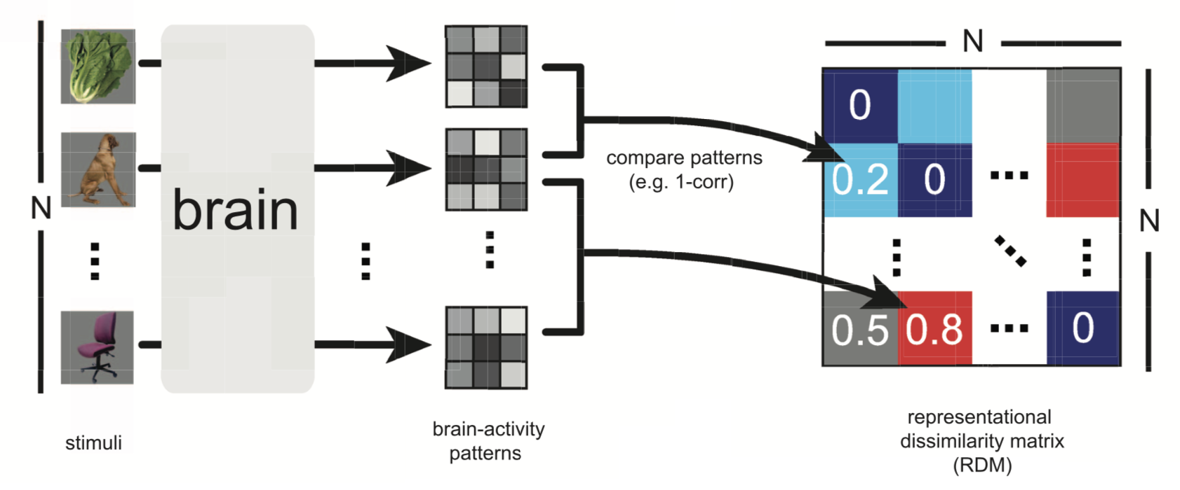
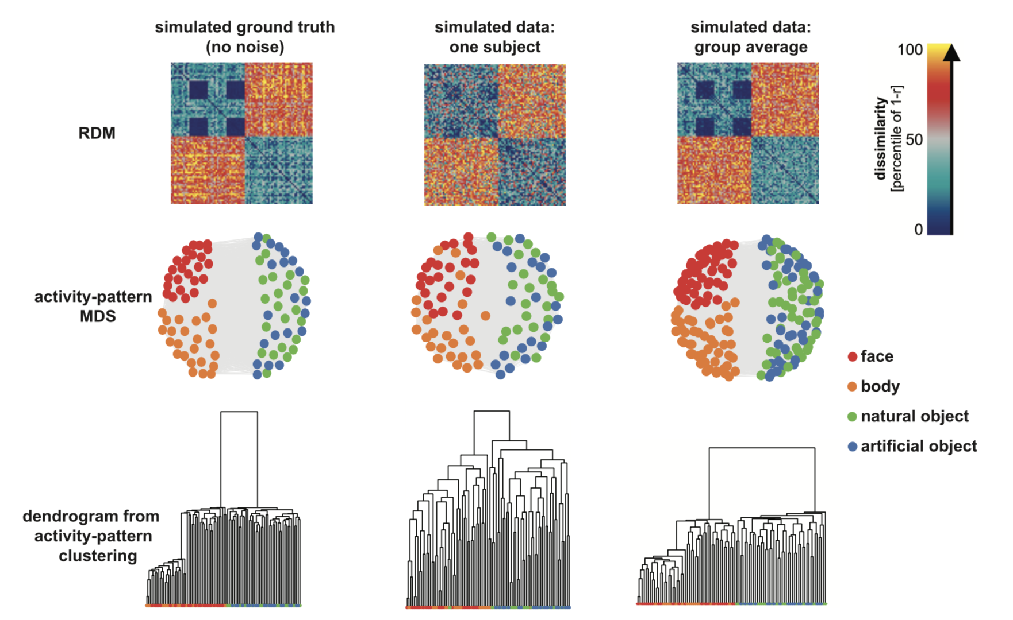
Step 1: Computing and visualizing RDMs
Dimensionality
Reduction method
for visualization
(MDS, t-SNE, PCA, UMAP, etc.)
Clustering
RDM
(Representational dissimilarity matrix)
Nili et al., 2014, PLoS Comp Biol

Slide 30
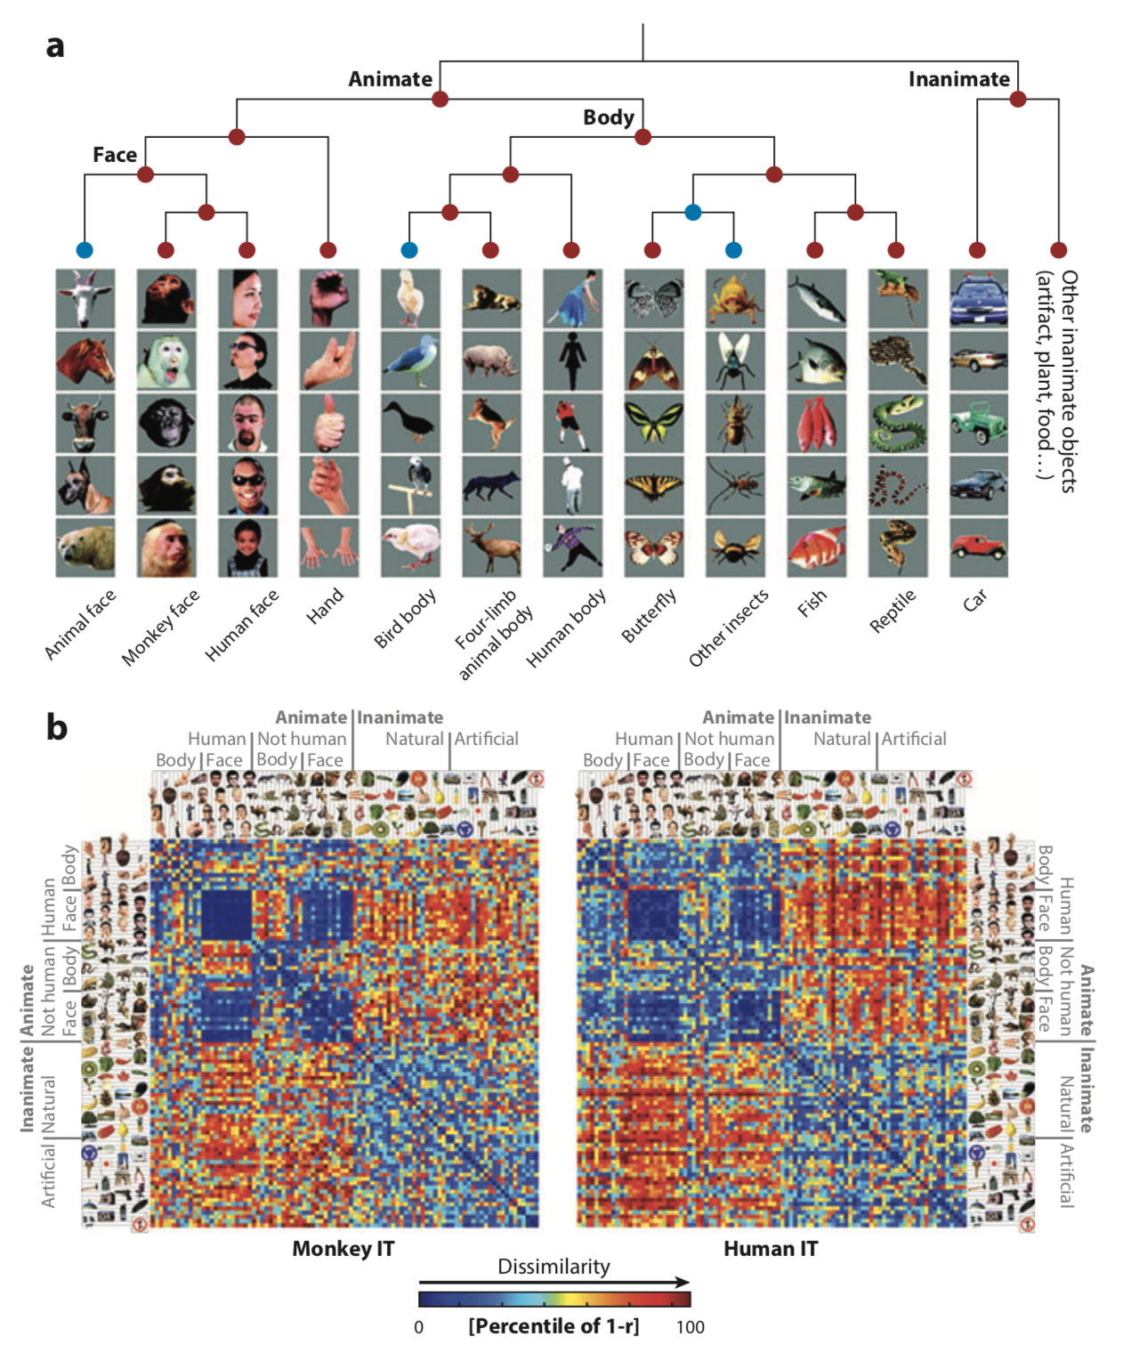
Step 1: Computing and visualizing RDMs
Real study examples:
Dendrogram derived from multiple single-unit recording in macaque inferior temporal (IT) cortex
(Kiani et al., 2007, J. Neurophysiol.)
Cross-modal, cross-species comparisons of RDM
for a common set of stimuli (Kriegeskorte et al., 2008, Neuron)
Haxby et al., 2014, Annu Rev Neurosci

Slide 31
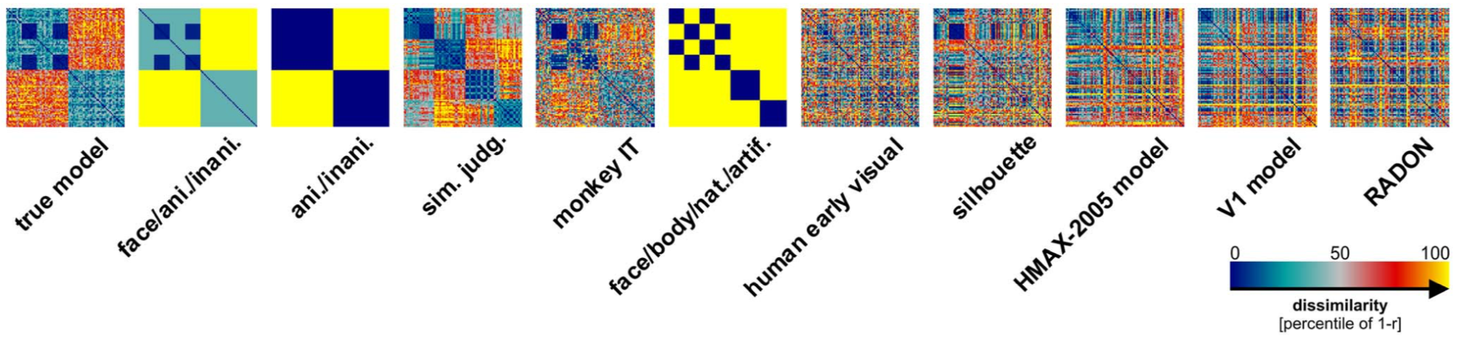
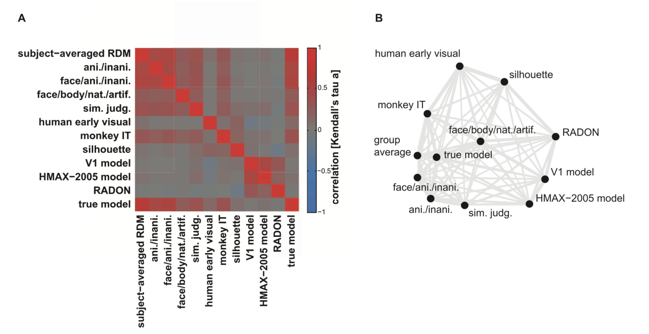
Step 2: Comparing brain and model RDMs
Many model RDMs
Comparing the RDMs:
using any metric that quantifies the extent to which two matrices are ‘‘in agreement’’
e.g., Spearman’s rank correlation,
Kendall’s tau a, etc.
Again, dimensionality reduction for visualization (MDS, PCA, t-SNE, force-directed graph drawing, etc.)
Nili et al., 2014, PLoS Comp Biol

Slide 32
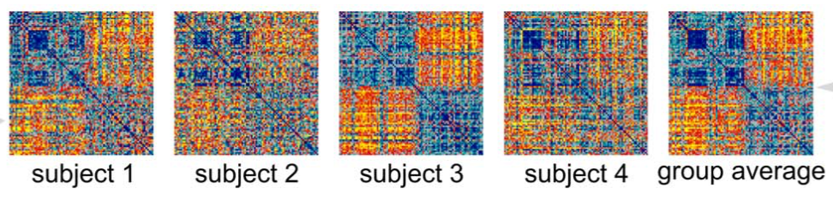
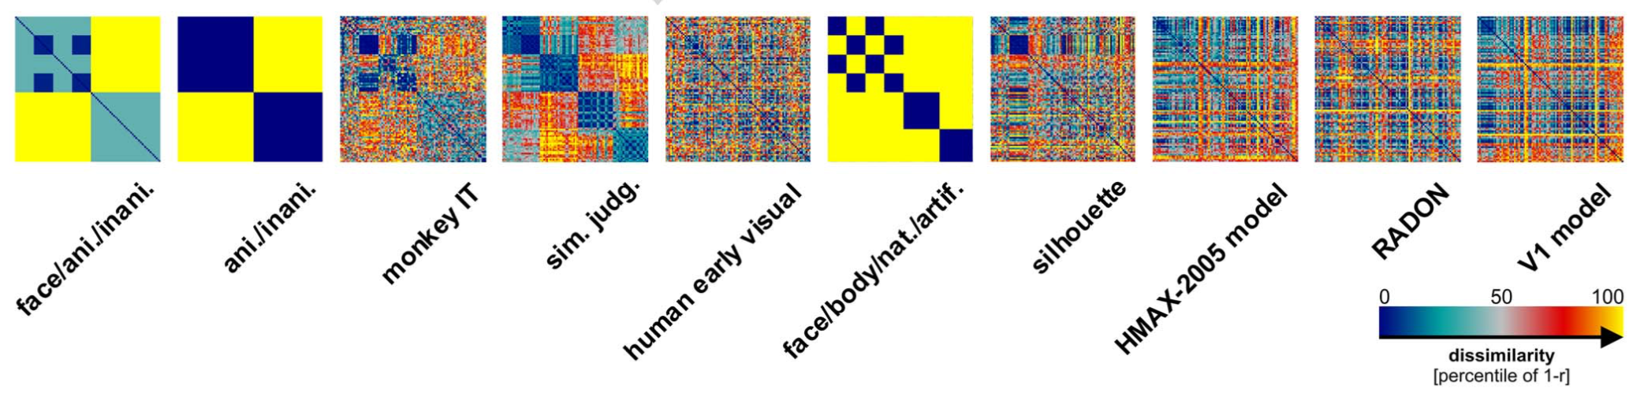
Step 3: Statistical inference
Now you have a reference RDM
…
You can compare them using Kendall’s tau a (or Spearman’s correlation)
and candidate RDMs
Nili et al., 2014, PLoS Comp Biol

Slide 33
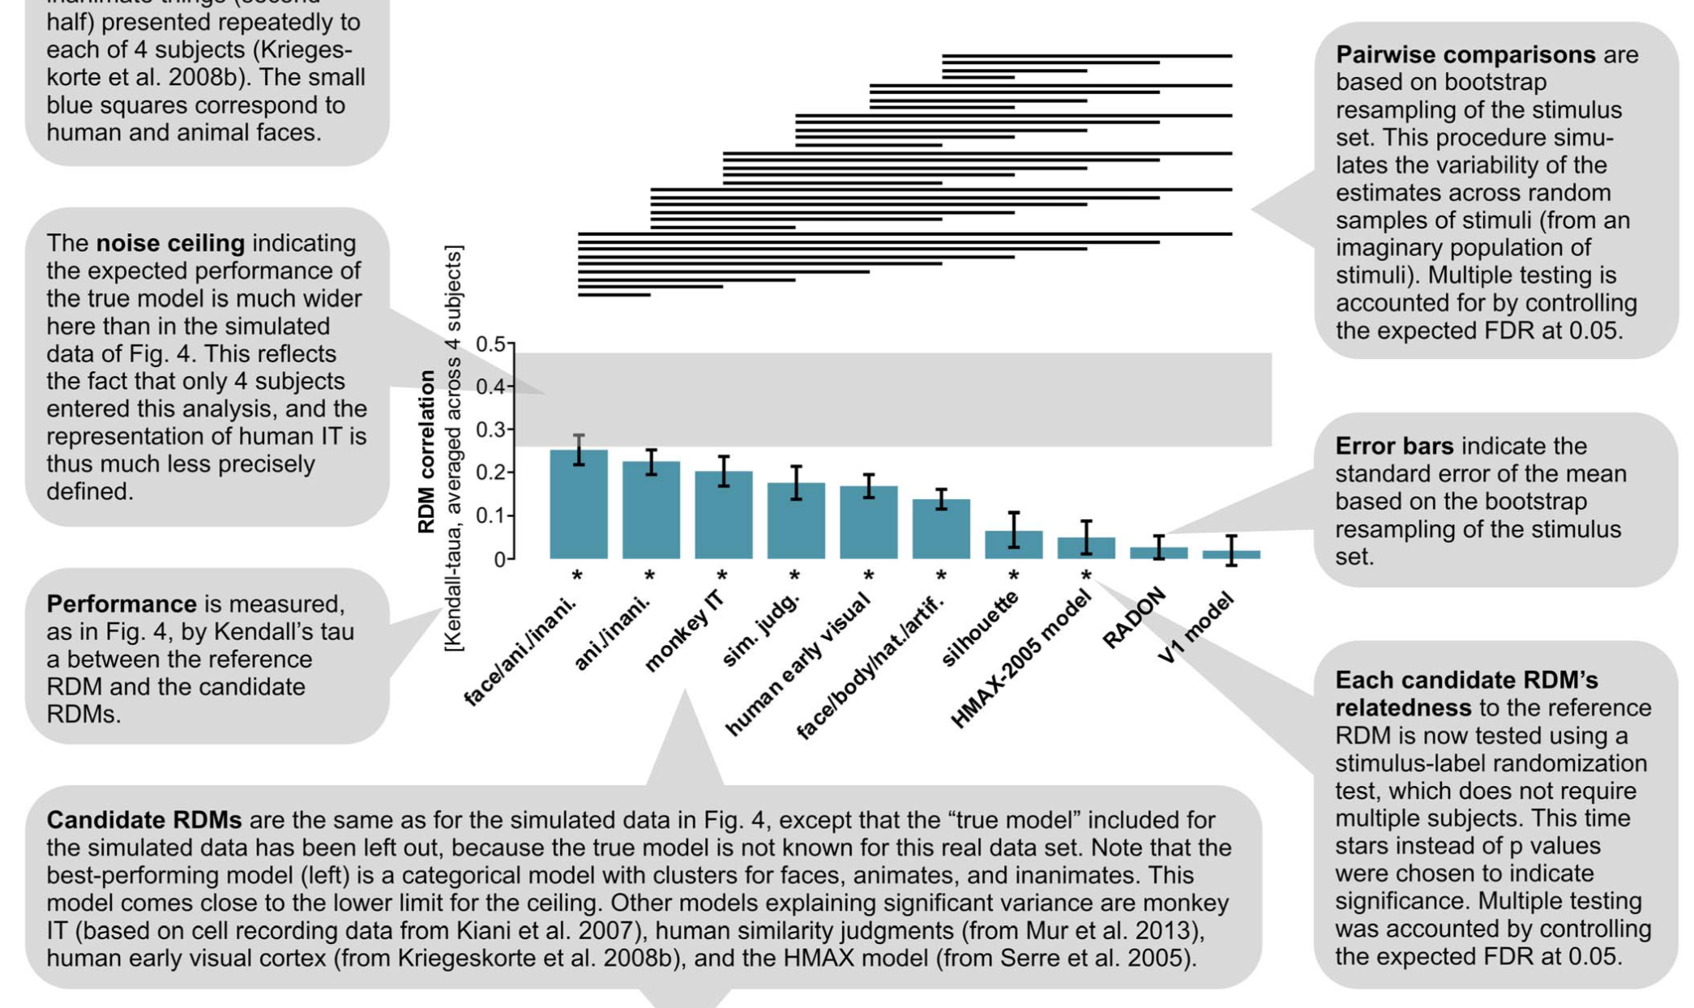
Step 3: Statistical inference
Note: This example uses data from 4 subjects with a large number of stimulus. Thus this uses resampling of the stimulus set. If you have a larger number of subjects, you can also do the resampling of subjects, not stimulus set.
Nili et al., 2014, PLoS Comp Biol

Slide 34
Step 3: Statistical inference
Noise ceiling:
Upper bound: average correlation between each participant’s RDM with the average RDM (overfitting)
Lower bound: leave-one-out correlation between one single subject’s RDM with the average RDM of others (underfitting)
Nili et al., 2014, PLoS Comp Biol

Slide 35
RSA (4): Examples and applications
Choong-Wan Woo
Director of the Cocoan Lab

Slide 36
Other RSA options
Other analysis options
Representational connectivity: Comparing brain RDMs among different regions
Use classification performance as a distance metric
Searchlight RSA: Each region serves as a model
Conducting RSA in the GLM context
Nili et al., 2014, PLoS Comp Biol

Slide 37
Other RSA options
Other analysis options
Representational connectivity: Comparing brain RDMs among different regions
Use classification performance as a distance metric
Searchlight RSA: Each region serves as a model
Conducting RSA in the GLM context
Nili et al., 2014, PLoS Comp Biol

Slide 38
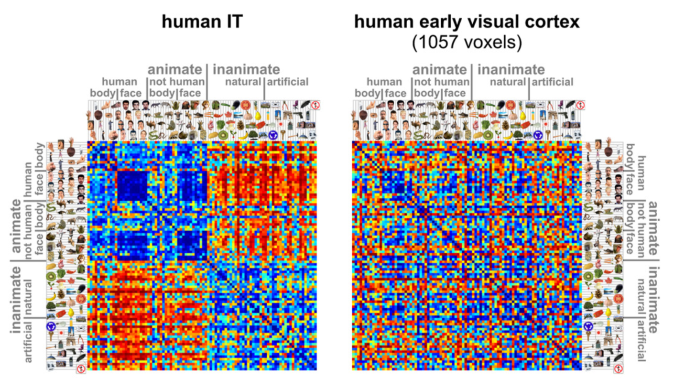
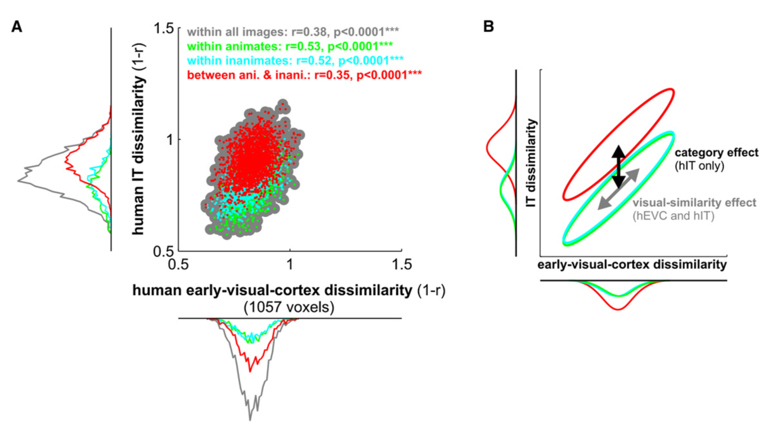
Example: 1. Representational connectivity
Kriegeskorte et al., 2008, Neuron

Slide 39
Other RSA options
Other analysis options
Representational connectivity: Comparing brain RDMs among different regions
Use classification performance as a distance metric
Searchlight RSA: Each region serves as a model
Conducting RSA in the GLM context
Nili et al., 2014, PLoS Comp Biol

Slide 40
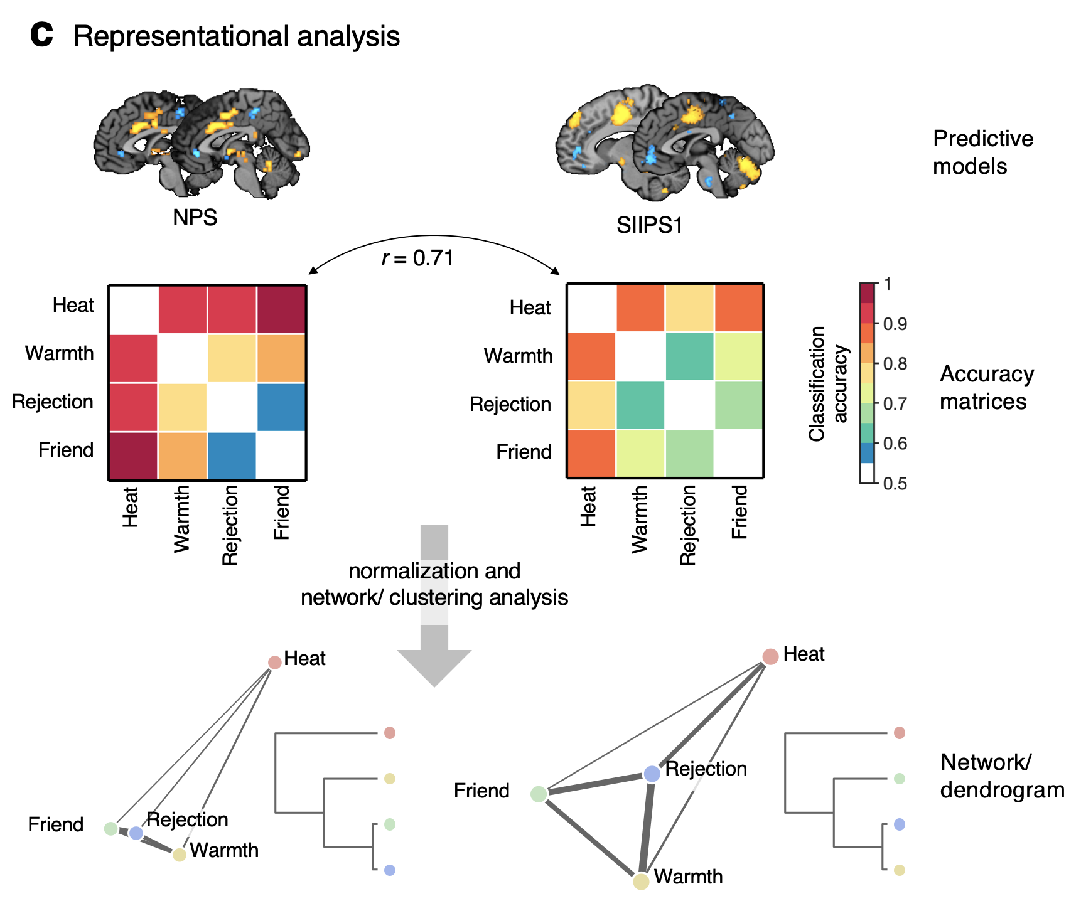
Example: 2. Accuracy as distance
Kohoutová et al., in revision

Slide 41
Other RSA options
Other analysis options
Representational connectivity: Comparing brain RDMs among different regions
Use classification performance as a distance metric
Searchlight RSA: Each region serves as a model
Conducting RSA in the GLM context
Nili et al., 2014, PLoS Comp Biol

Slide 42
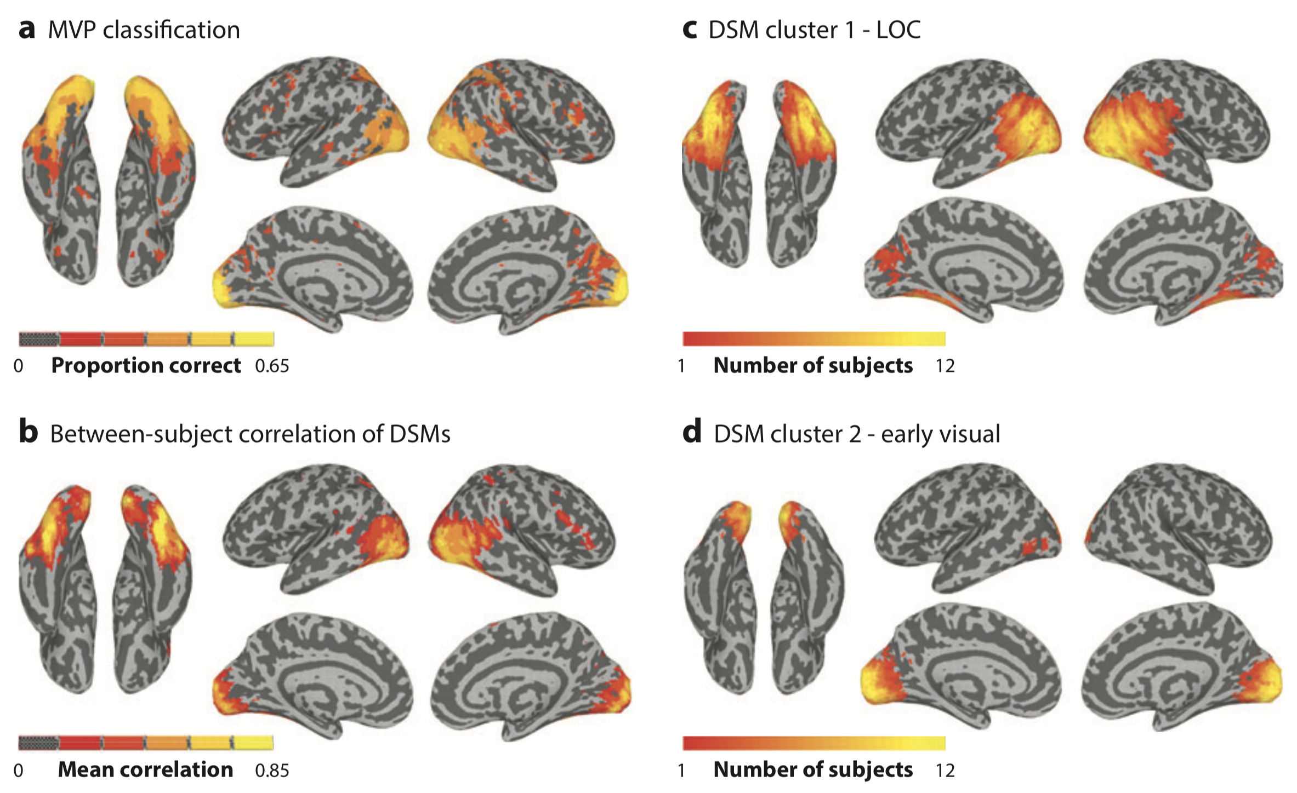
Example: 3. Searchlight RSA
In addition to the MVPA, we can calculate the RDM (in this figure, DSM) for each person, and see between-subject consistency of the RDMs
Haxby et al., 2014, Annu Rev Neurosci

Slide 43
Example: 3. Searchlight RSA
We can also cluster the regions based on the RDM patterns (for each individual or for group)
Haxby et al., 2014, Annu Rev Neurosci

Slide 44
Other RSA options
Other analysis options
Representational connectivity: Comparing brain RDMs among different regions
Use classification performance as a distance metric
Searchlight RSA: Each region serves as a model
Conducting RSA in the GLM context
Nili et al., 2014, PLoS Comp Biol

Slide 45
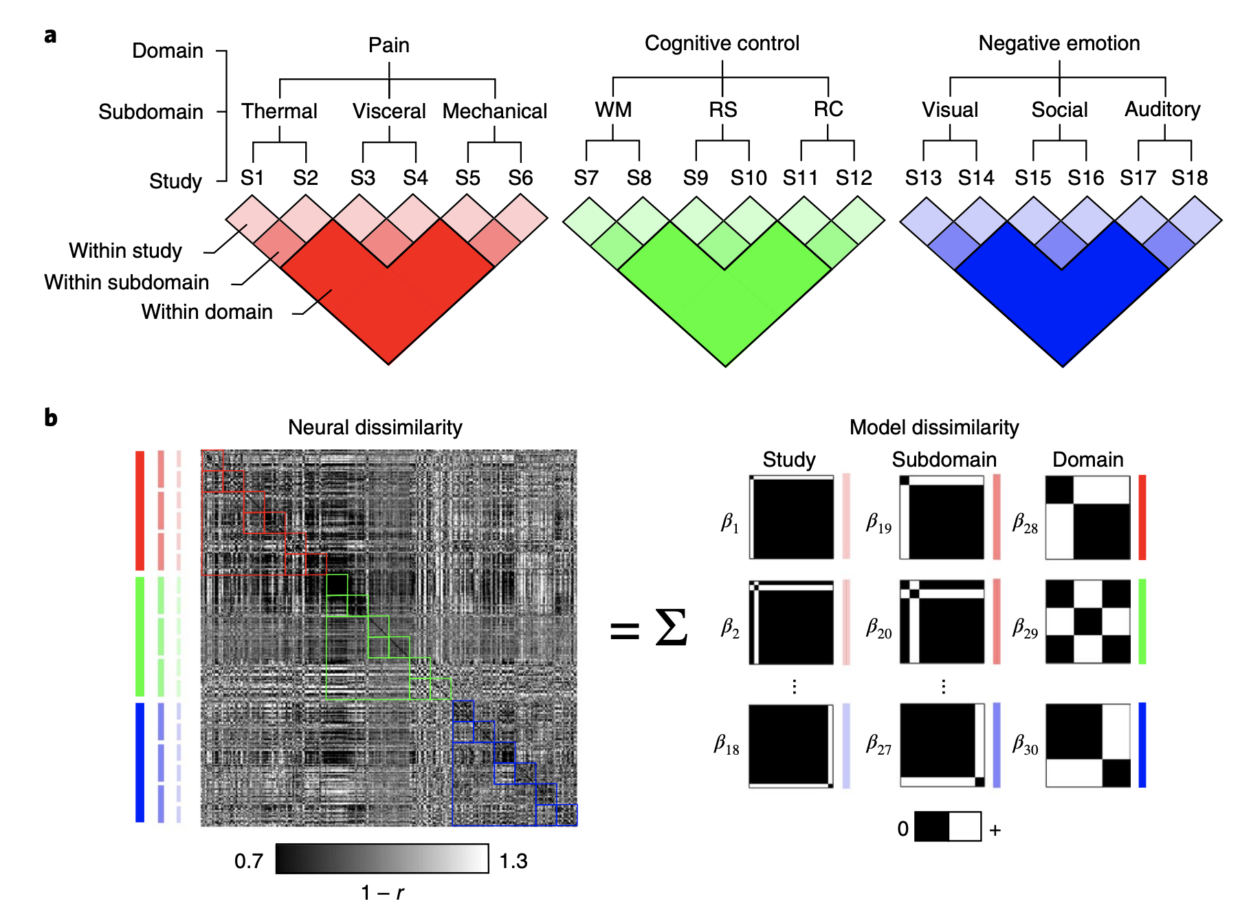
Example: 4. RSA in the GLM context
Kragel et al., 2018, Nat Neurosci

Slide 46
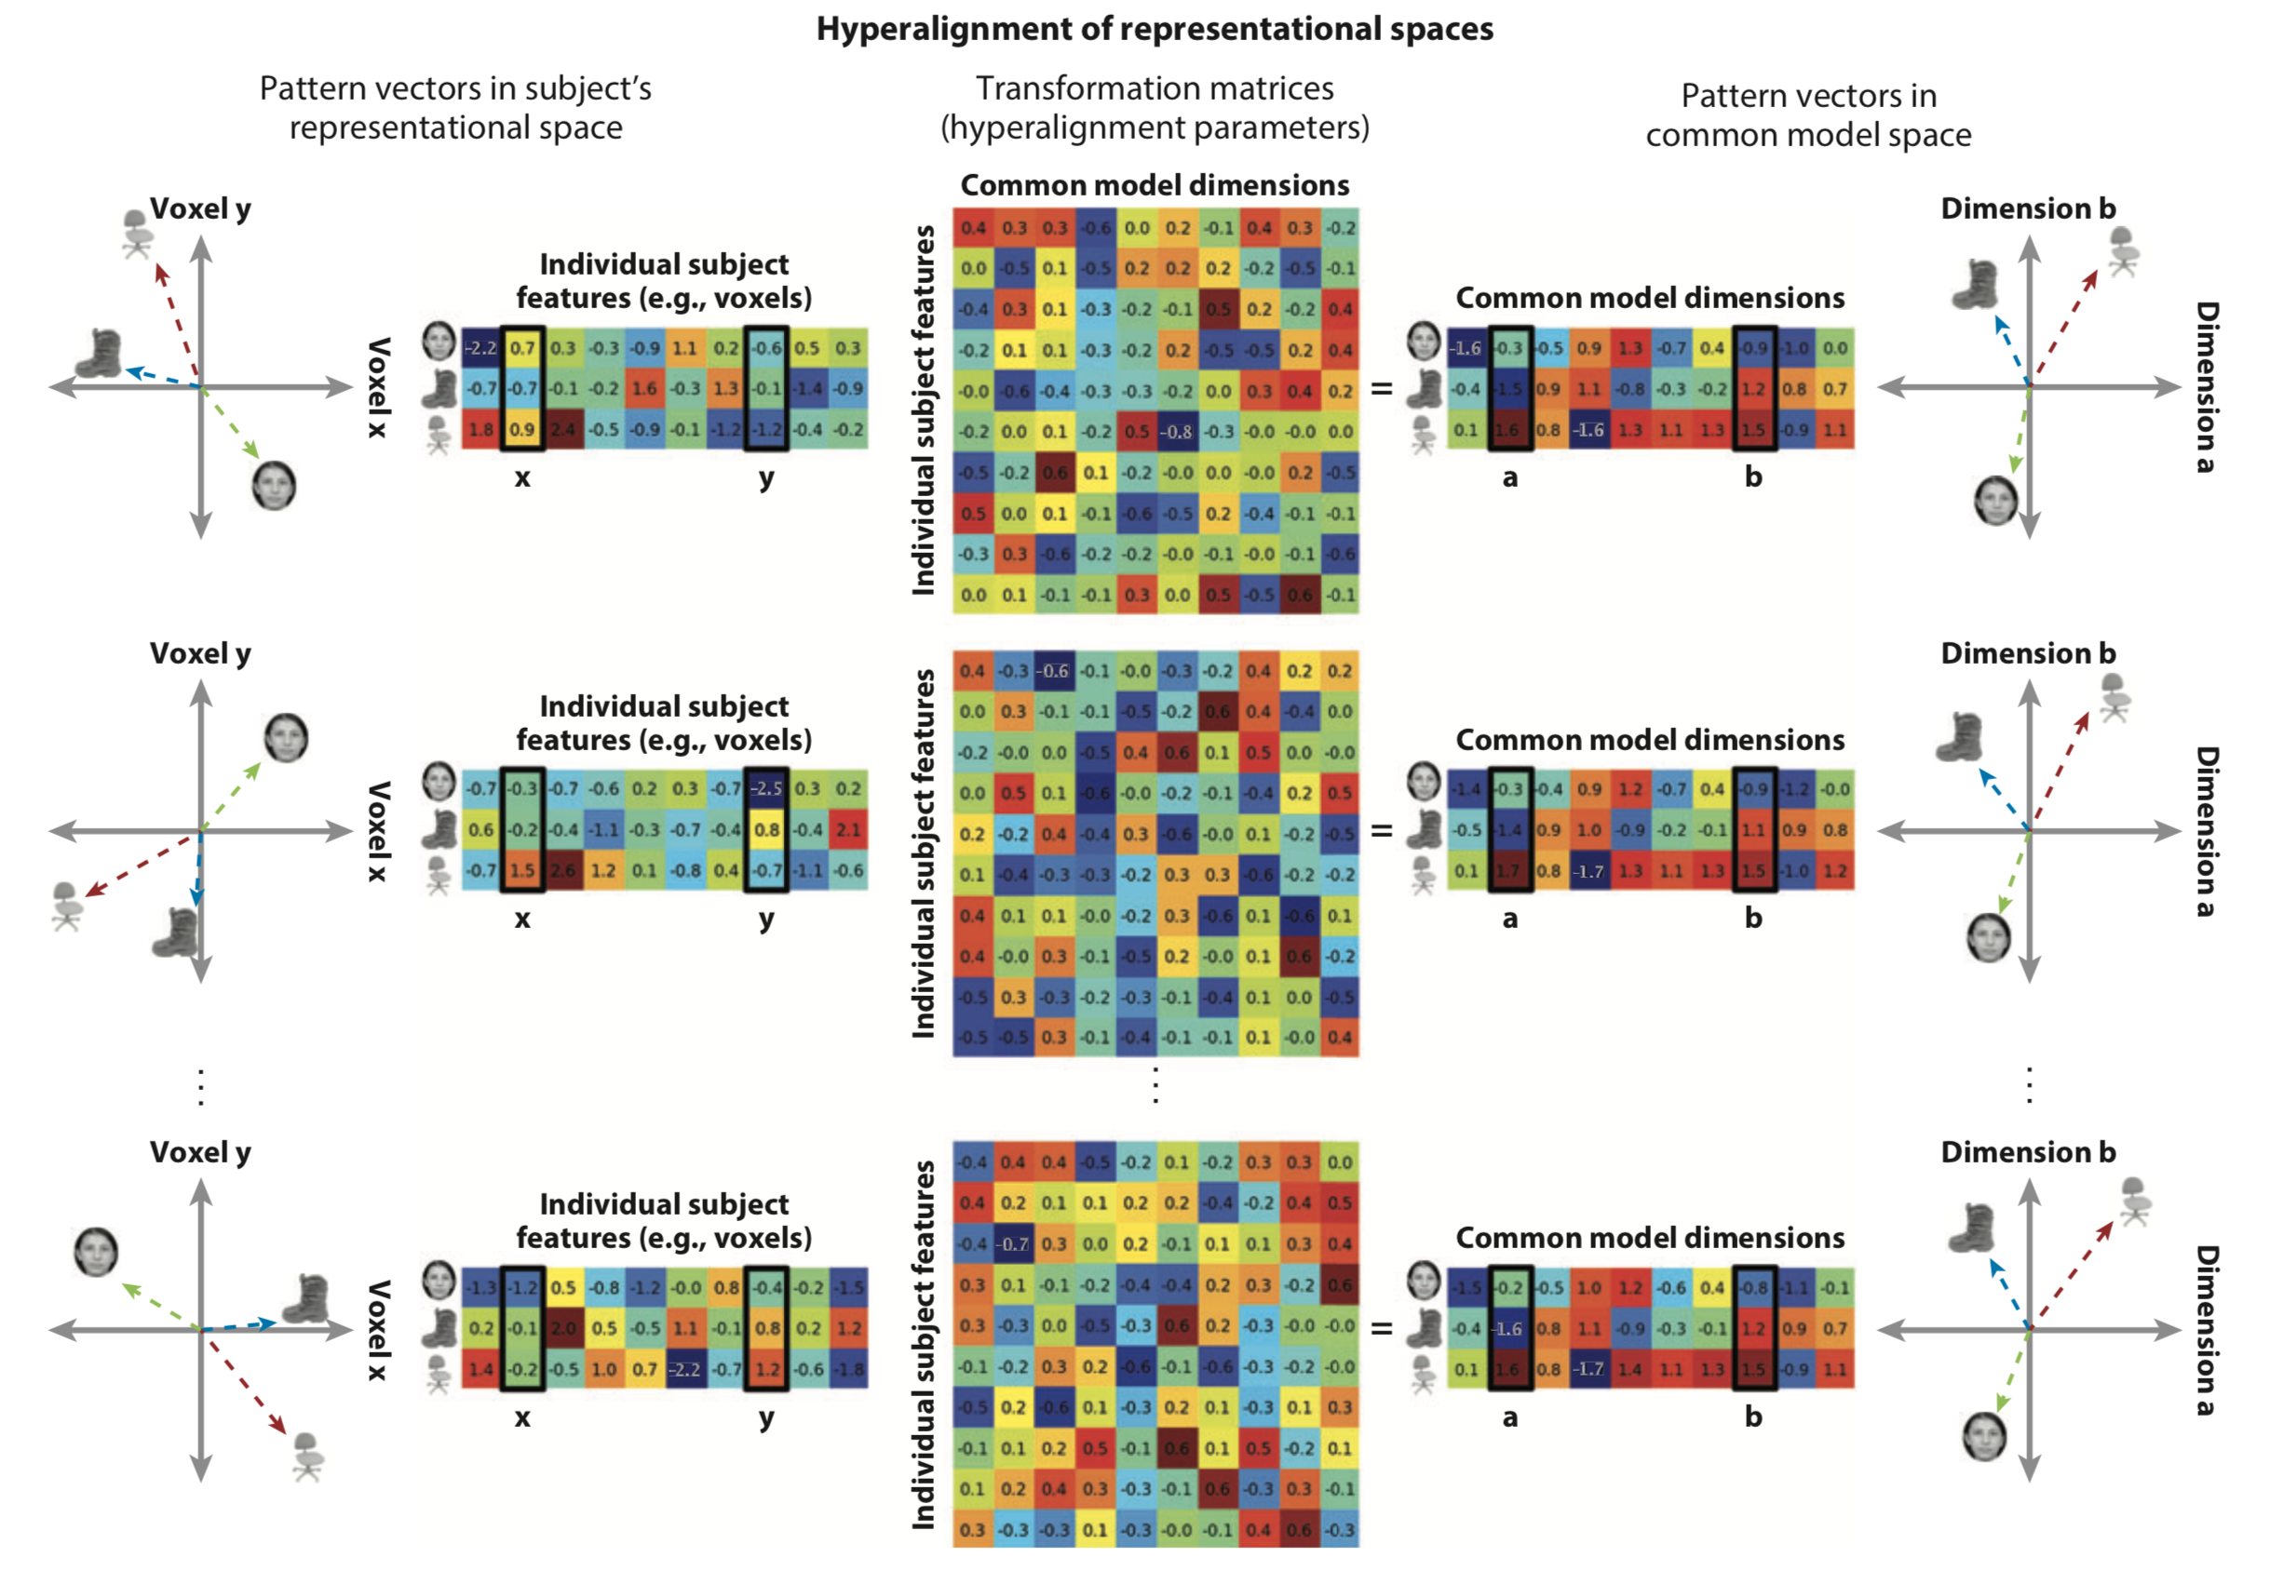
Additional relevant technique
Not easy to directly compare the representational spaces across people
Hyper-alignment:
aligning individual neural representational spaces into a common model space
Iterative procrustean transformation to the common representational space
Haxby et al., 2014, Annu Rev Neurosci; Haxby et al., 2011, Neuron

Slide 47
Procrustes
From Greek mythology,
Procrustes (or “the stretcher”) was a bandit from Attica
He attached people by stretching them or cutting off their legs, so as to force them to fit the size of an iron bed
The word "Procrustean" is thus used to describe situations where different lengths or sizes or properties are fitted to an arbitrary standard.
(from Wikipedia)
https://en.wikipedia.org/wiki/Procrustes
Haxby et al., 2014, Annu Rev Neurosci; Haxby et al., 2011, Neuron

Slide 48
Procrustes analysis
Haxby et al., 2014, Annu Rev Neurosci; Haxby et al., 2011, Neuron

Slide 49
Hyperalign using procrustean transformation
Haxby et al., 2014, Annu Rev Neurosci

Slide 50
Thank you for your attention
Hope our representations about “RSA” to be well-aligned

Slide 51
RSA (5): Tutorial
Choong-Wan Woo
Director of the Cocoan Lab

Slide 52
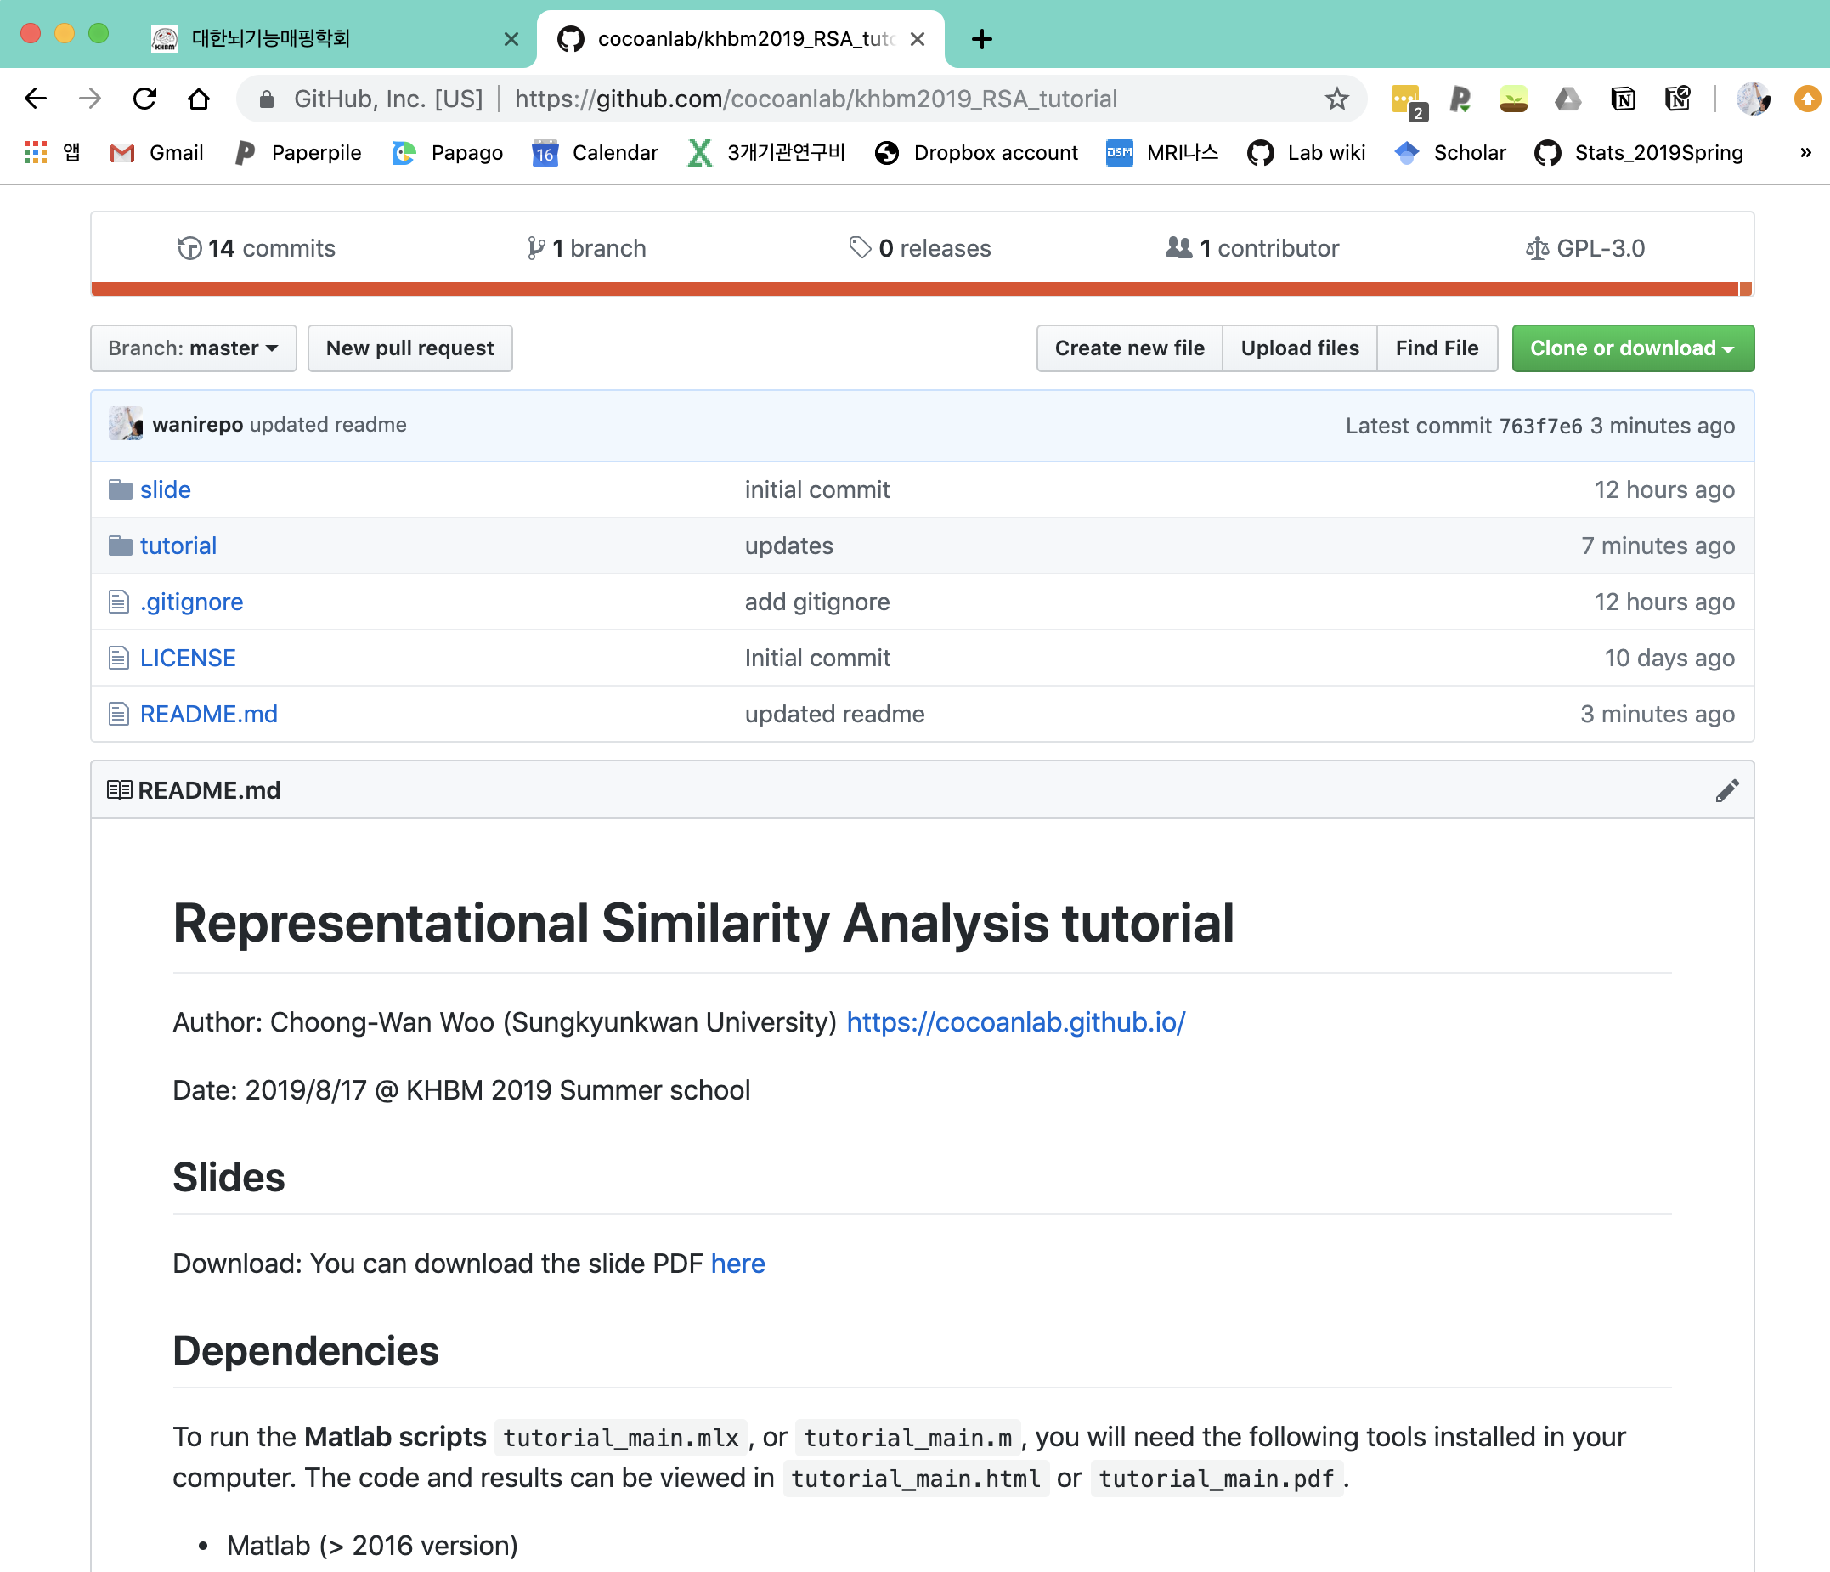
In the tutorial session:
https://github.com/cocoanlab/khbm2019_RSA_tutorial
Step 1: Computing and visualizing RDMs
Step 2: Comparing brain and model RDMs
Step 3: Statistical inference

Slide 53
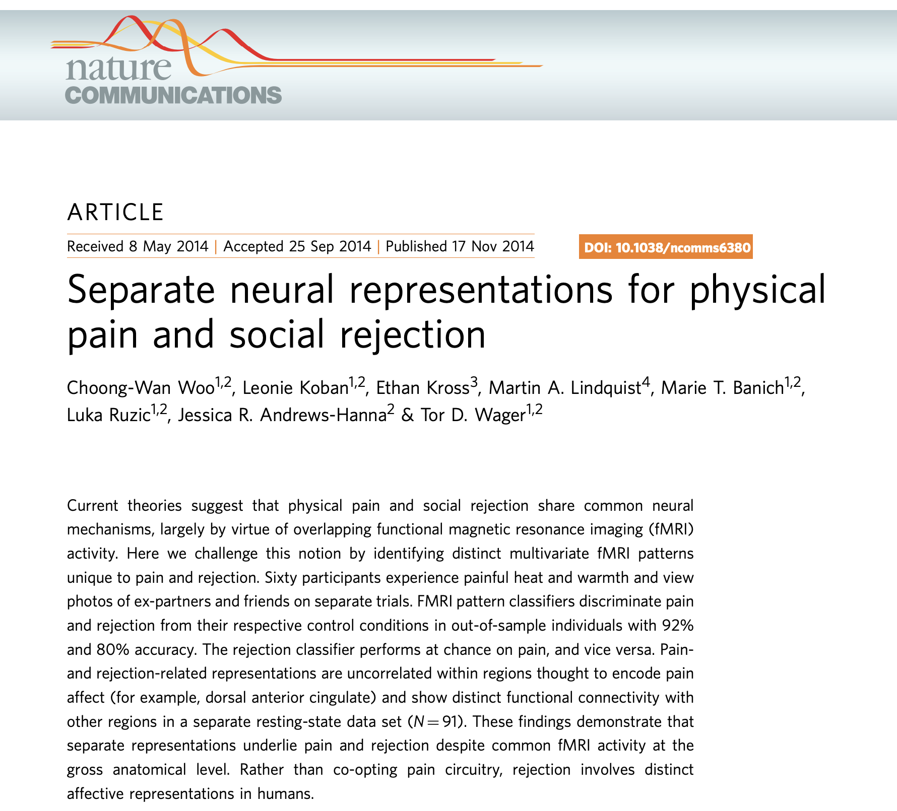
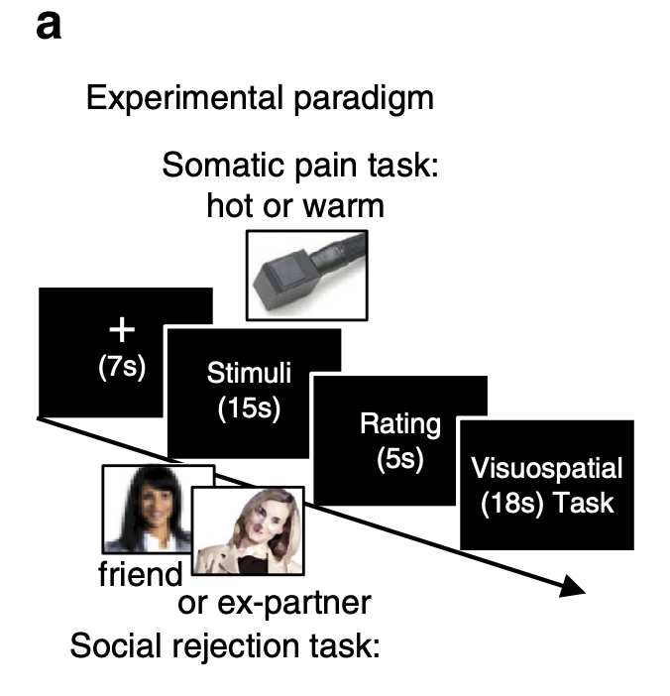
Data and research question:
Original question: Can we identify specific patterns of fMRI activity for physical pain and social pain, respectively?
We conducted an fMRI experiment (N = 59) using somatic and social pain tasks.
All 59 individuals (31 females, M_{age} = 20.8, SD_{age} = 3.0) recently experienced an unwanted break-up with their romantic partners and felt intensely rejected.
Tasks:

Slide 54
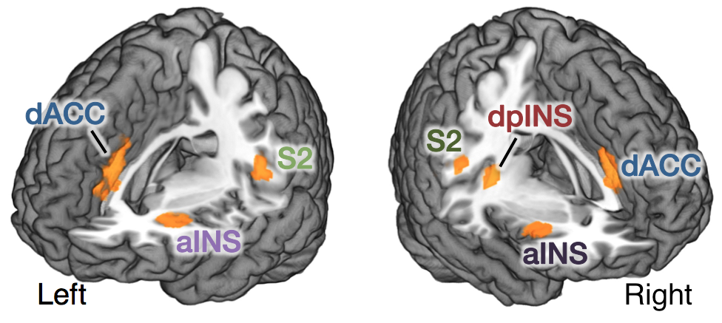

Data and research question:
Traditional mapping results
Univariate overlap
between [Heat-pain vs. Warmth] and [Ex-partner vs. Friend]
The foundation of the “social pain” theory
Then, we used the predictive mapping approach (linear support vector machines, SVMs) to obtain specific multivariate fMRI pattern for pain and rejection on the same dataset.
Notes:
Then, we wanted to see the replication of the univariate analysis results, that is the overlapping fMRI activations within core pain-processing regions, including dACC and aINS. In the univariate analysis, the task or condition contrast becomes an independent variable, and fMRI signal from each voxel becomes a dependent variable. Through massive univariate analyses, we aim to get the mapping between each voxel and a task or a function. From this univariate analysis, we were able to replicate previous findings, that there were overlapping activations within dACC, aINS, and also the secondary somatosensory cortex and right dorsal posterior insula, which are all among the core pain-processing regions.
Then, we did the multivariate pattern analysis on the same dataset. In contrast to the univariate analysis, brain-wide fMRI activity becomes independent variables all together similar to multiple regression, and tasks or behavioral outcomes become dependent variables. Here, somatic pain and social pain conditions are y. Given that we have much more predictor variables than observations, we need to use machine learning algorithms to get more stable prediction model. So, we used linear support vector machines to discriminate heat-pain and ex-partner conditions from their control conditions.

Slide 55
Data and research question:
Notes:
Then, we examined the pattern similarity of SVM weights within the regions that are activated by both pain and rejection. We found that none of these regions showed significant correlations between pain and rejection patterns. We also examined pattern similarity of contrast images for pain and rejection for each participant. And again, none of these regions showed significant correlations. So, we can conclude that none of the pain-processing regions that demonstrated overlapping fMRI activity between pain and rejection showed a significant correlation in terms of SVM classifier weights and the contrast raw images.

Slide 56







Data and research question:
1. Computing and visualizing RDMs for each participant, for each region
Whole-brain mask based on neurosynth
(Woo et al., 2014)
x = -5
5
x = -39
39
z = -5
4
14
23
33
42
aMCC
aINS
S2/dpINS
TPJ
2. Computing four model RDMs with these ROI RDMs
Heat vs. others
Rejection vs. others
Physical vs. social
Aversive vs. non-aversive
Question: Which one of these is the best-supported model based on the representational similarity patterns from data?

